Slide 1




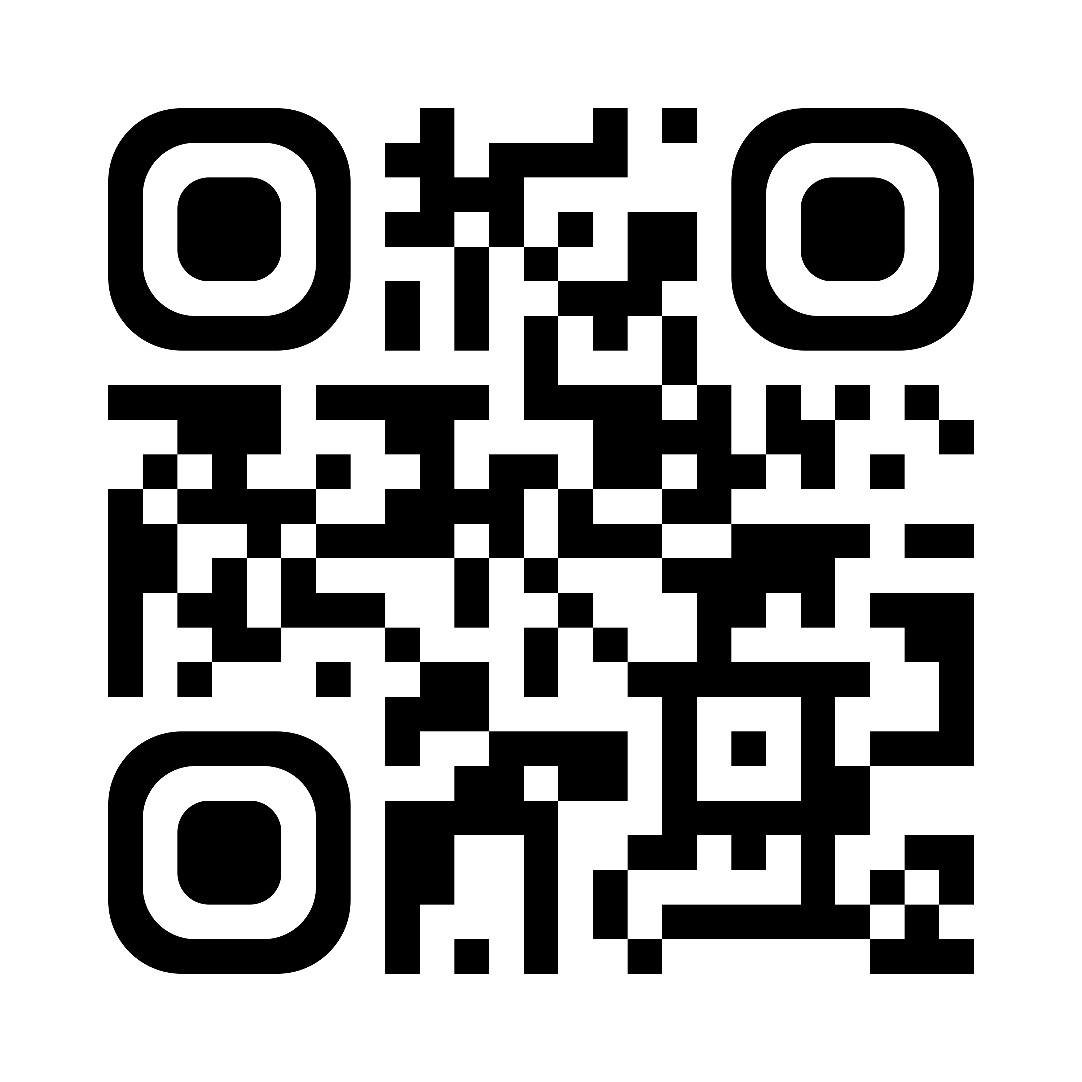
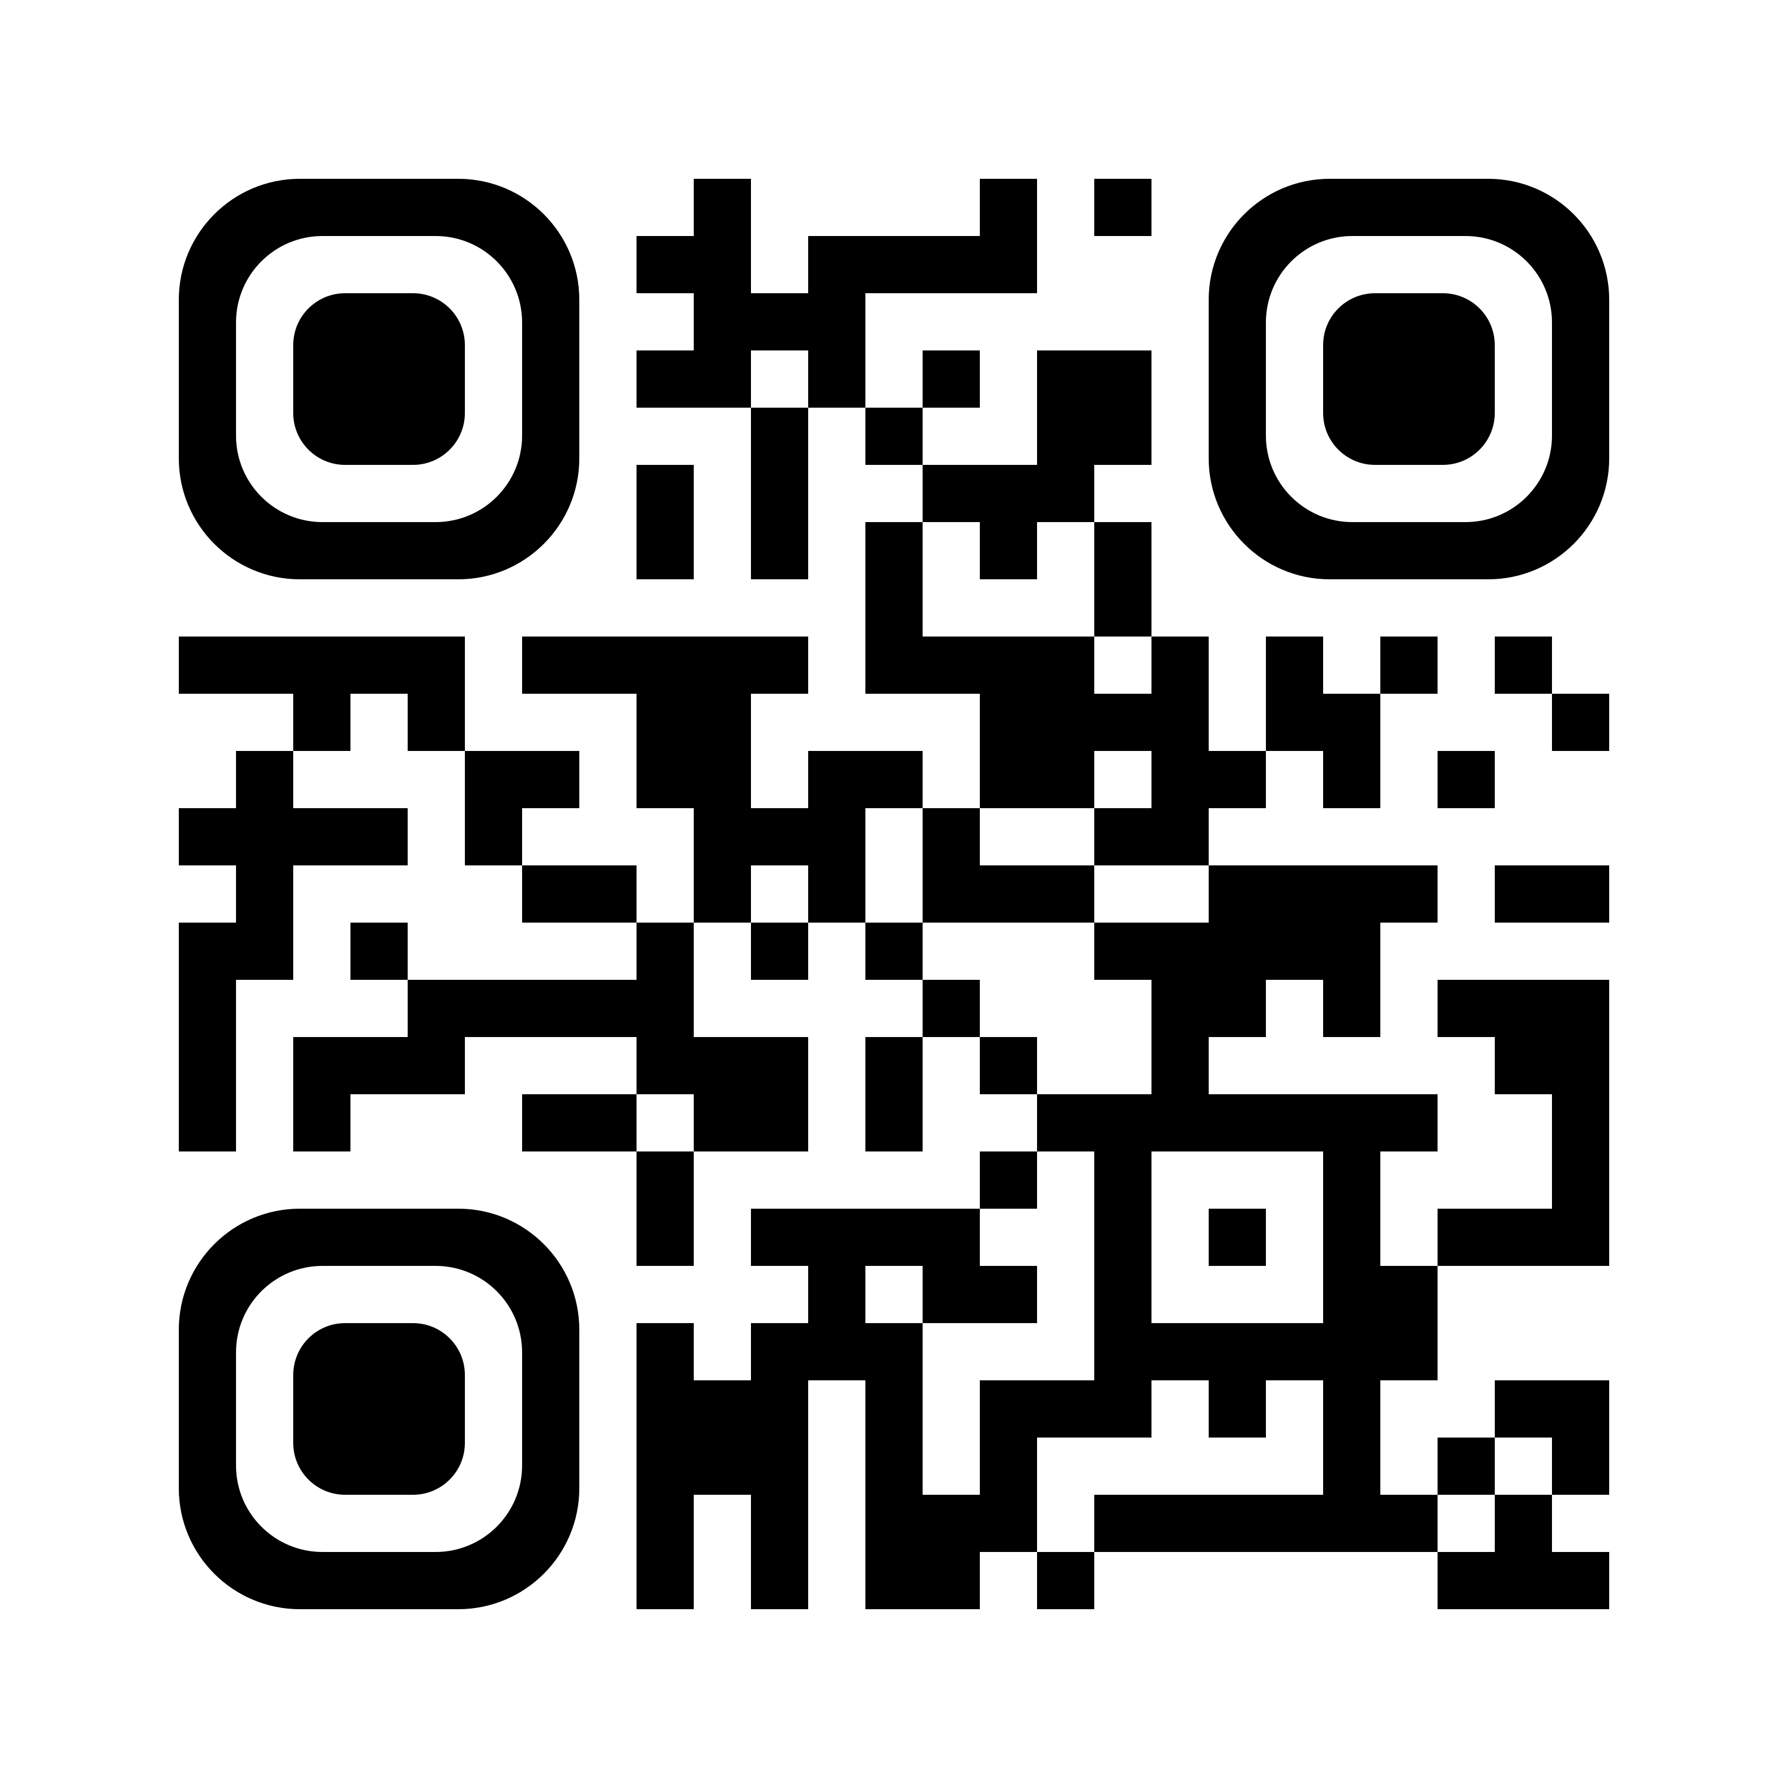
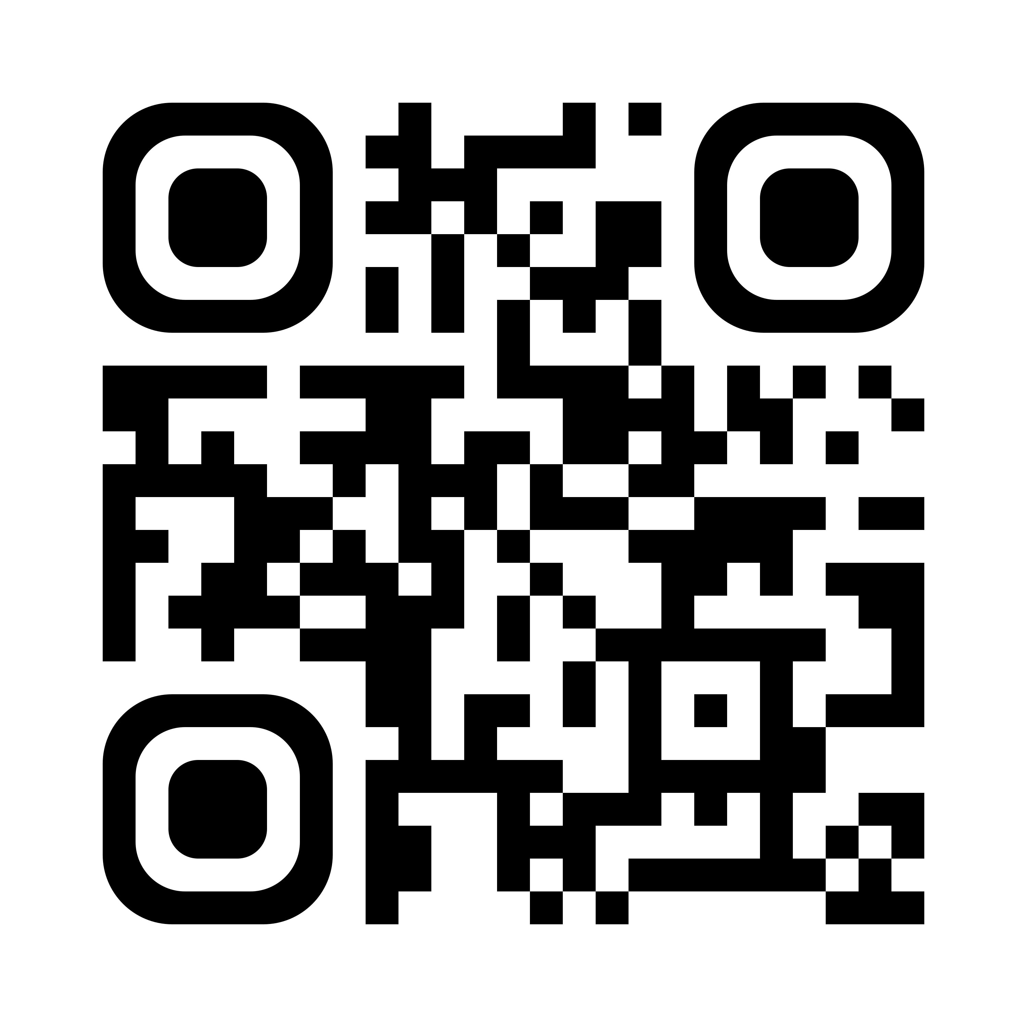
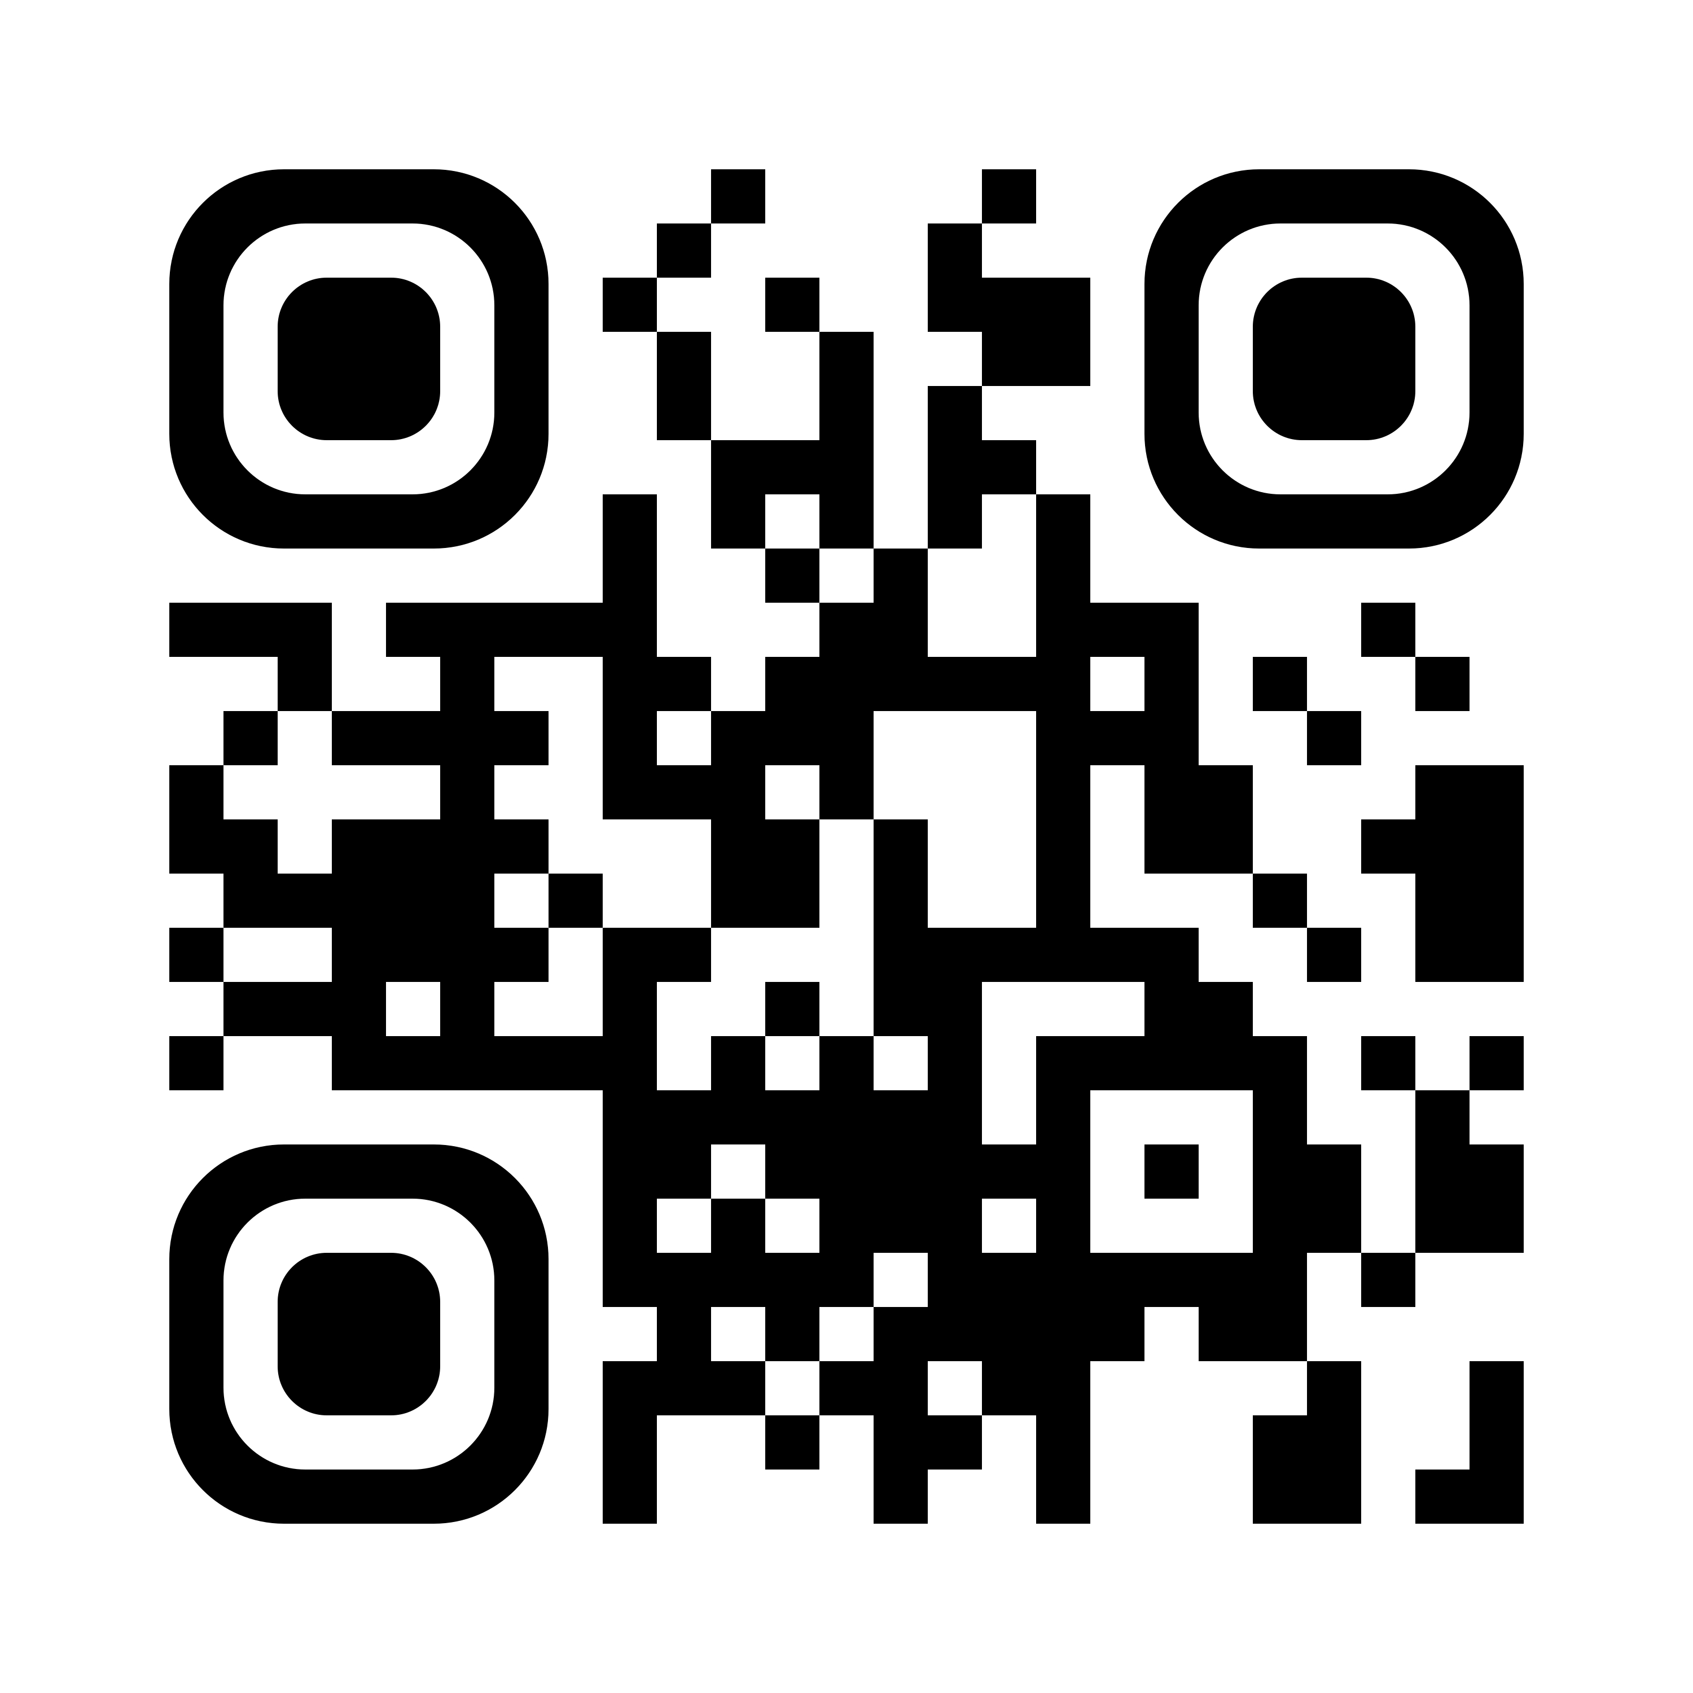
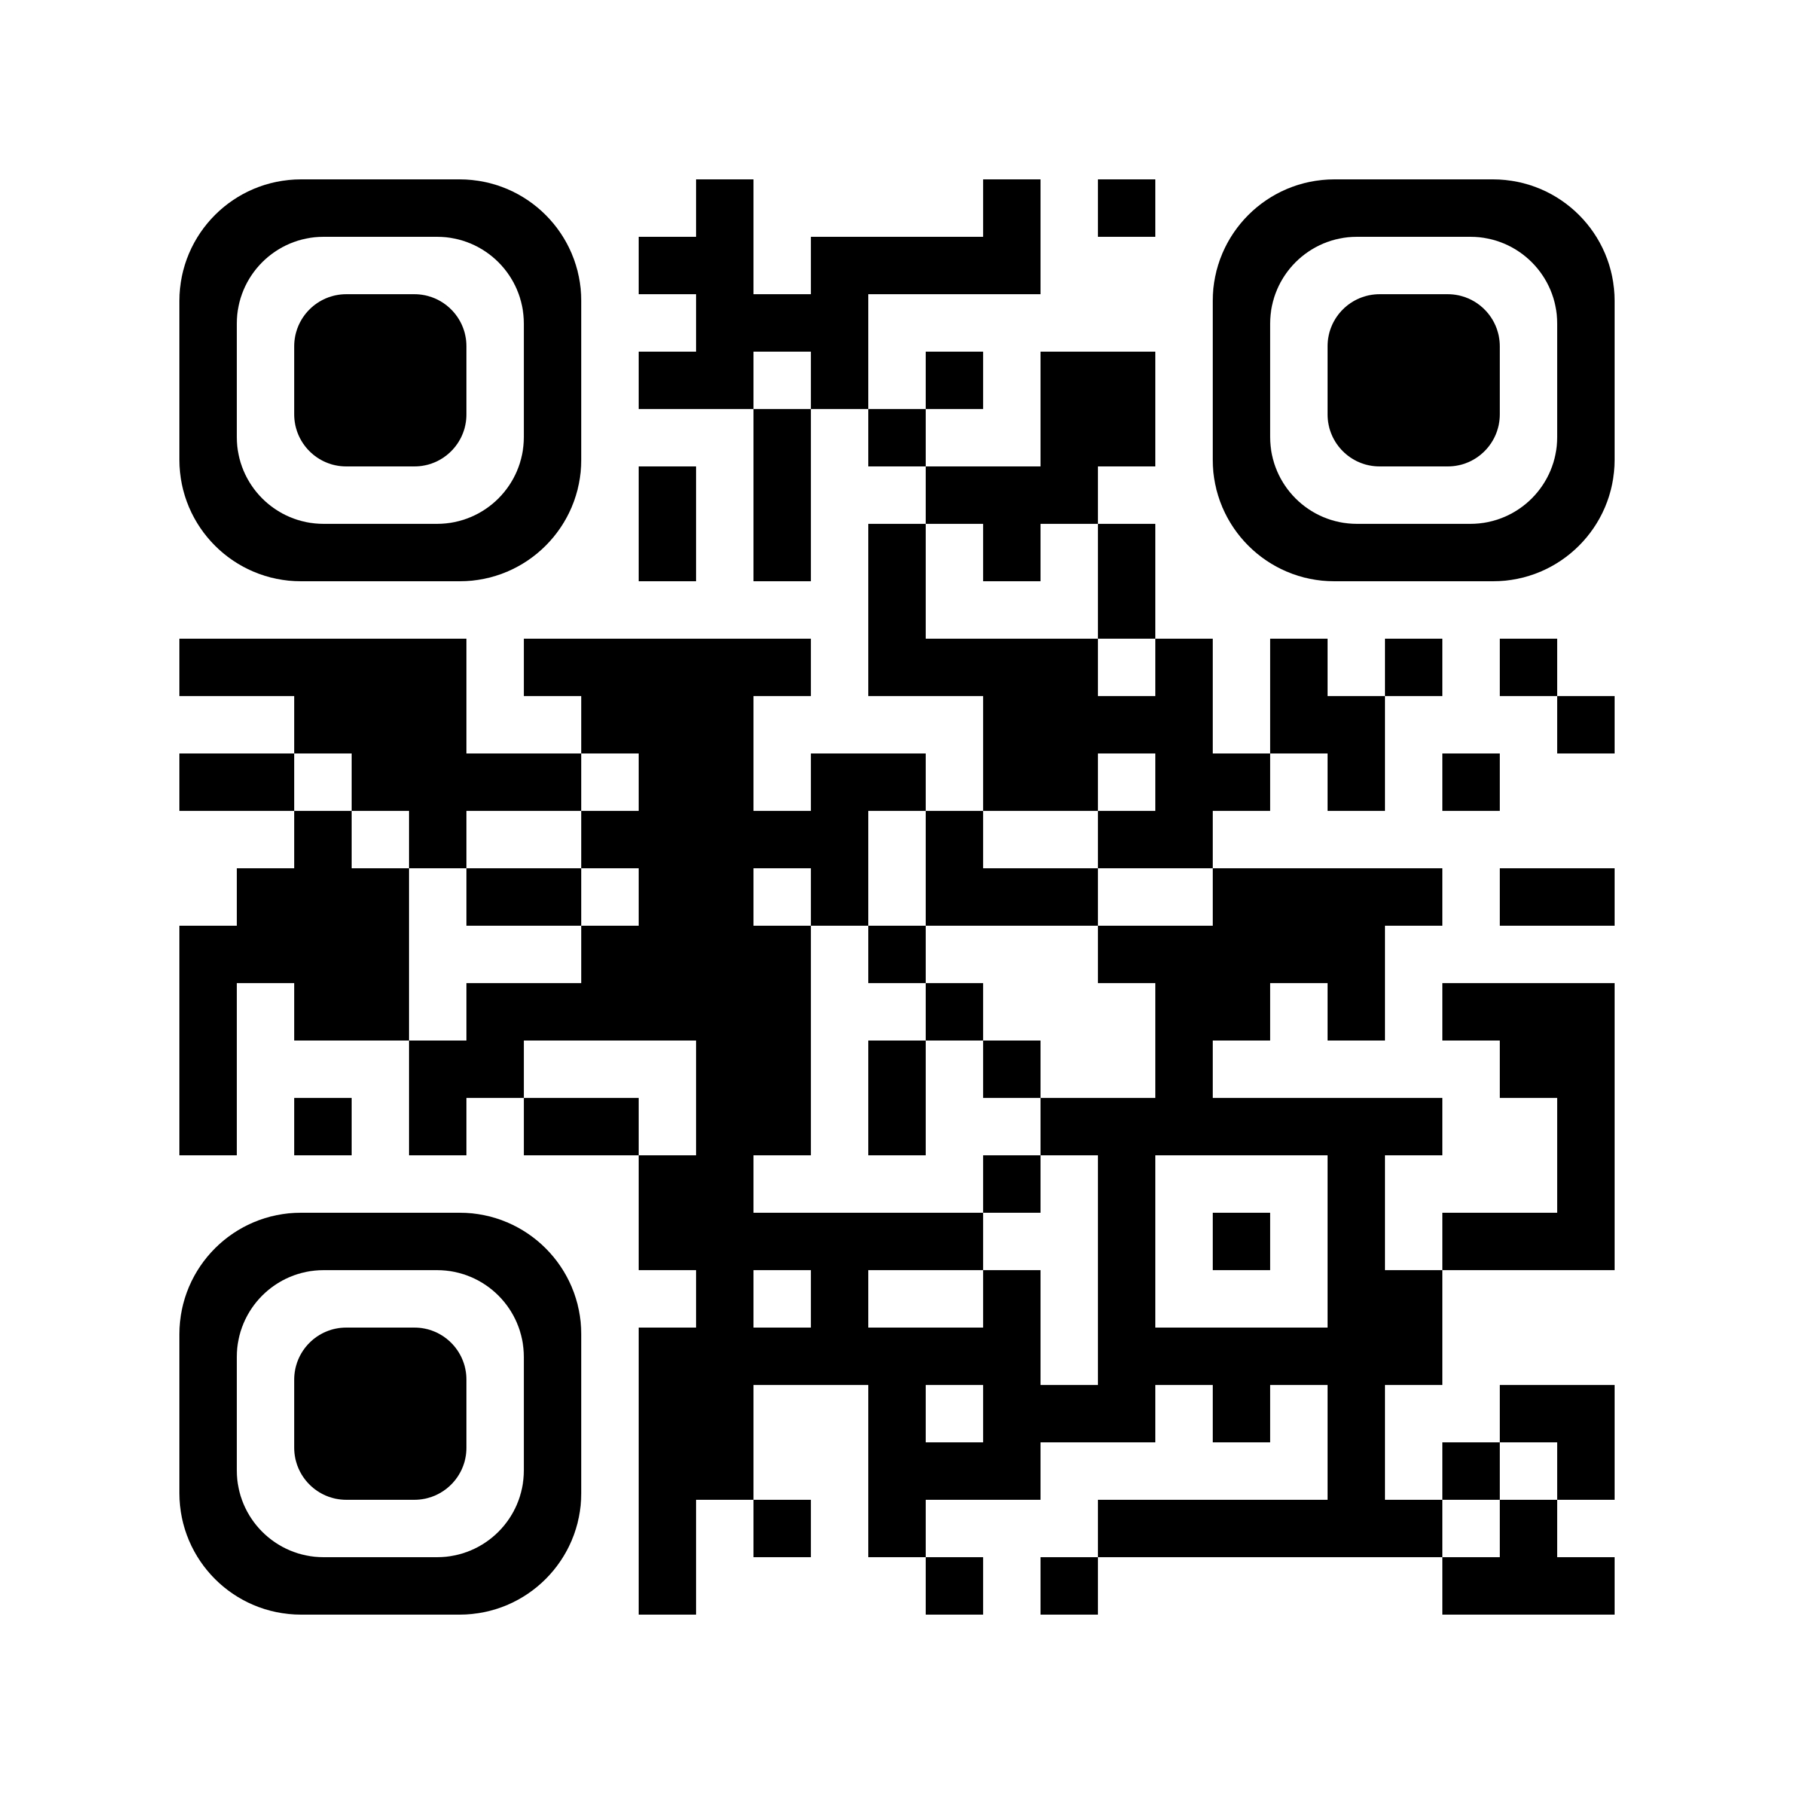


AVS Social Media Platforms
AVS
Bluesky
X
@American Vacuum Society AVS
@avs-members
@AmericanVacuumSociety
@AVS_Members
@avs_events
Linked in
Facebook
Instagram

Slide 2





AVS Events & Resources
Publications Library
Browse or submit to JVST A, JVST B, Biointerphases, SSS, or AVS Quantum Science.
Technical Library
Review AVS conference presentations, recommended practices, as well as online educational training in fields related to materials, processing, and interfaces.
Upcoming Events & Training
Explore the AVS Events calendar for upcoming conferences, short courses, webinars, e-talks, and more.
@AmericanacuumSociety
@AVS_Members
@American Vacuum Society AVS
Buyers Guide
Search our expansive directory of companies for the products and services that you need in fields related to materials, processing, and interfaces.
Career Services
Expand your search for qualified candidates or share your résumé/CV with leading employers.
www.avs.org

Slide 3
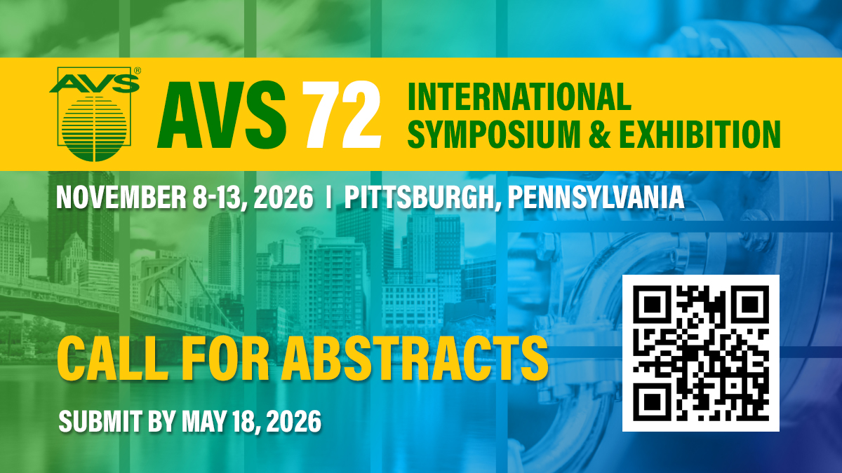

Slide 4
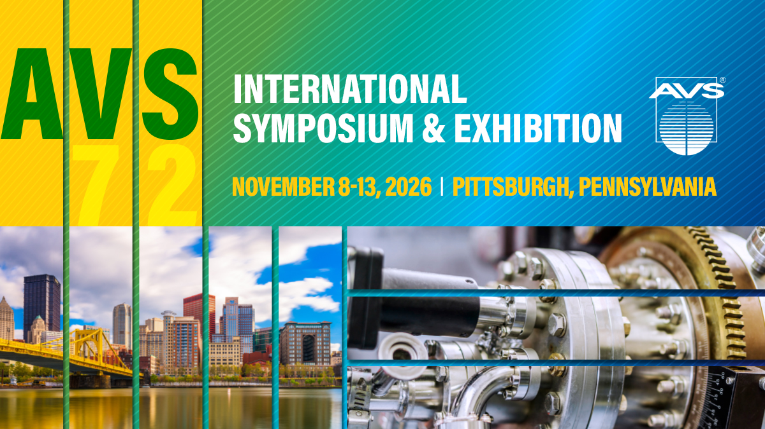

Slide 5
Call for AVS Major Awards Nominations
Major Awards: Due March 31, 2026
Outstanding Theoretical and/or Experimental Accomplishments:
Medard W. Welch Award
Outstanding Discoveries and Inventions:
Gaede-Langmuir Award
Outstanding Theoretical or Experimental Work by an Early Career Scientist: Peter Mark Memorial Award
Sustained and Outstanding Technical Contributions:
Fellow of the Society
Outstanding Performance in Technical Support of
Research and Development
George T. Hanyo Award

Slide 6
Call for AVS Student Awards Nominations
Student Awards: Due May 18, 2026
Outstanding Research by a Graduate Student:
Dorothy M. and Earl S. Hoffman
Award and Scholarship
Nellie Yeoh Whetten Award
Russell and Sigurd Varian Award
Graduate Research Award
Students May Apply for a National Student Award and One Division/Group Award in Each Year

Slide 7


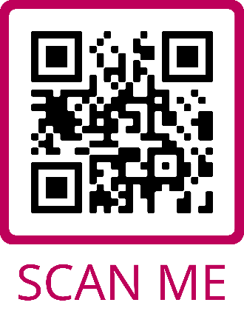
Join the AVS Community
JOIN AVS
Membership Benefits:
Earn Awards and Recognition for Your Scientific or Mentoring Accomplishments
Receive Discounts on AVS Conference Registrations and Other Professional Development and Training
Access the Publications and Technical Libraries and Other Technical Resources
Take Advantage of Career Services
Participate in Student and Early Career Member Activities
Get Involved in Networking, Leadership, or Other Volunteer Opportunities at the Local, National, or International Levels
Discover the Impact and Camaraderie of AVS Membership
Scan to Access and Complete the Membership Form or Learn More at WWW.AVS.ORG
$135
Platinum Full
$40
Platinum Student

Slide 8


ABOUT AVS
AVS Basics
Volunteer Organization
Chapters, Groups, and Divisions
As an interdisciplinary, professional Society, founded in 1953, AVS supports networking among academic, industrial, government, and consulting professionals involved in a wide variety of disciplines related to materials, interfaces, and processing.
AVS is a Member Society of AIP comprised of 4,000 members worldwide.
10 Divisions
3 Technical Groups
16 Regional Chapters
2 International Chapters
9 International Affiliates
6 Student Chapters
5-8 Focus Topics/Symposia

Slide 9


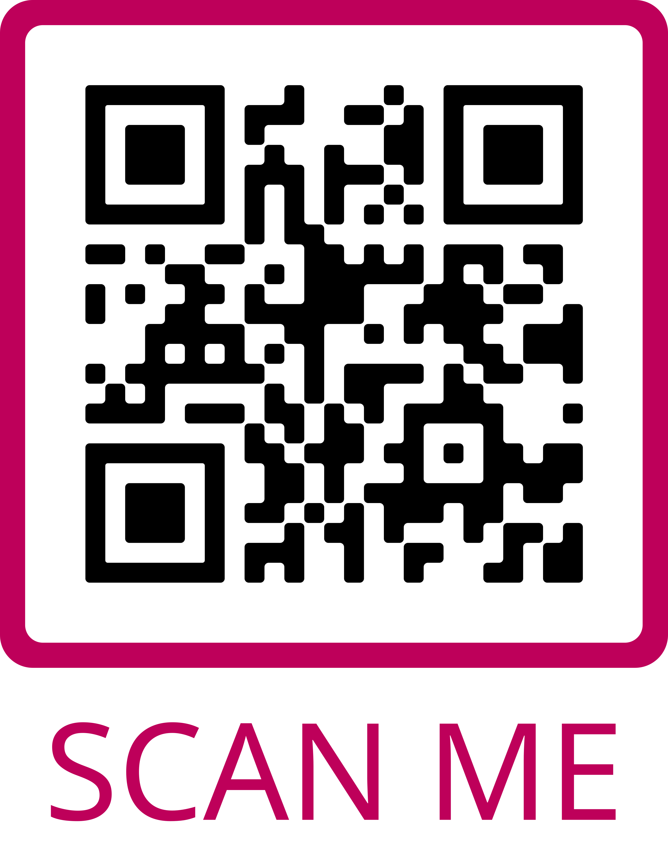

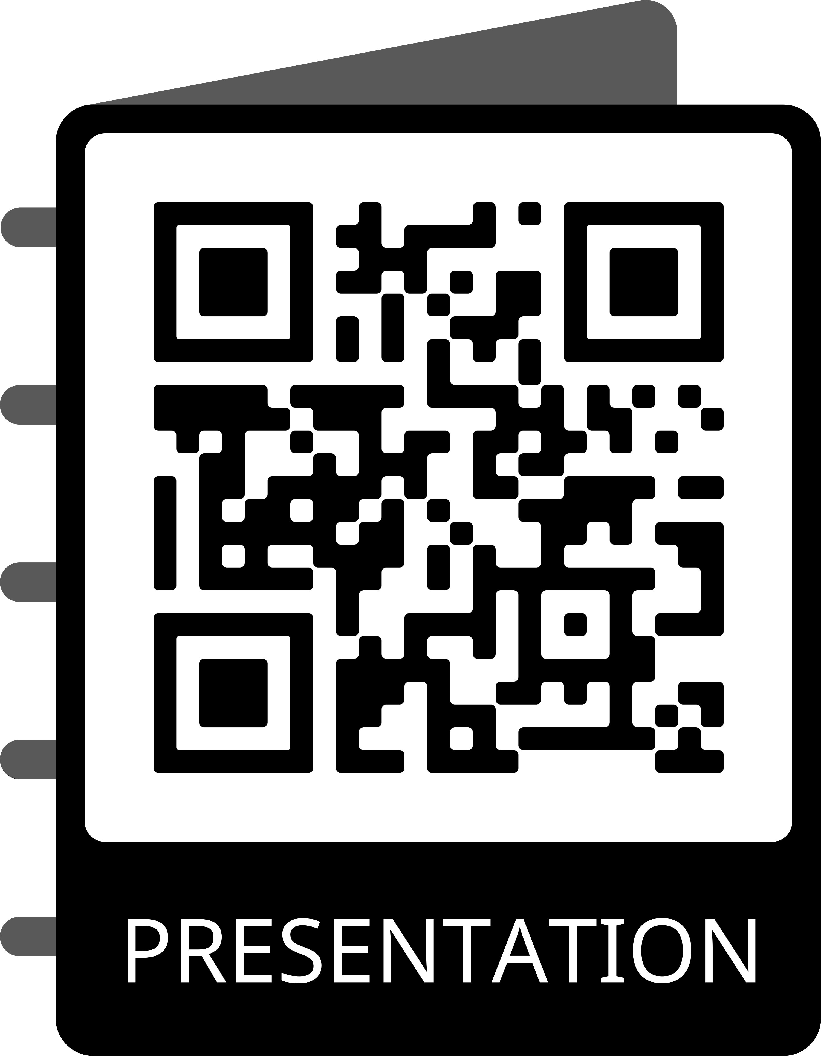

AVS BASICS
New and Improved MyAVS Featuring:
Streamlined Navigation
Cleaner Look and Feel
Simpler Social Media Engagement
Login to MyAVS to:
Join or Renew Online - Print Receipts or Invoices
Maintain Your Profile - Add Your Photo, If Desired
Access and Print Membership Card
Reset Your Password or Request Your Username in Real Time
View New Member Tips
Access the Publications and Technical Libraries
Review Chapter and Division Affiliations
Look for the Latest Insurance and Long-Term Care Discounts
Purchase Official AVS Merchandise
Features Coming in 2026: Online Communities + More
Your Portal to All AVS Member Benefits
Scan to Access MyAVS
Scan to View This Presentation

Slide 10




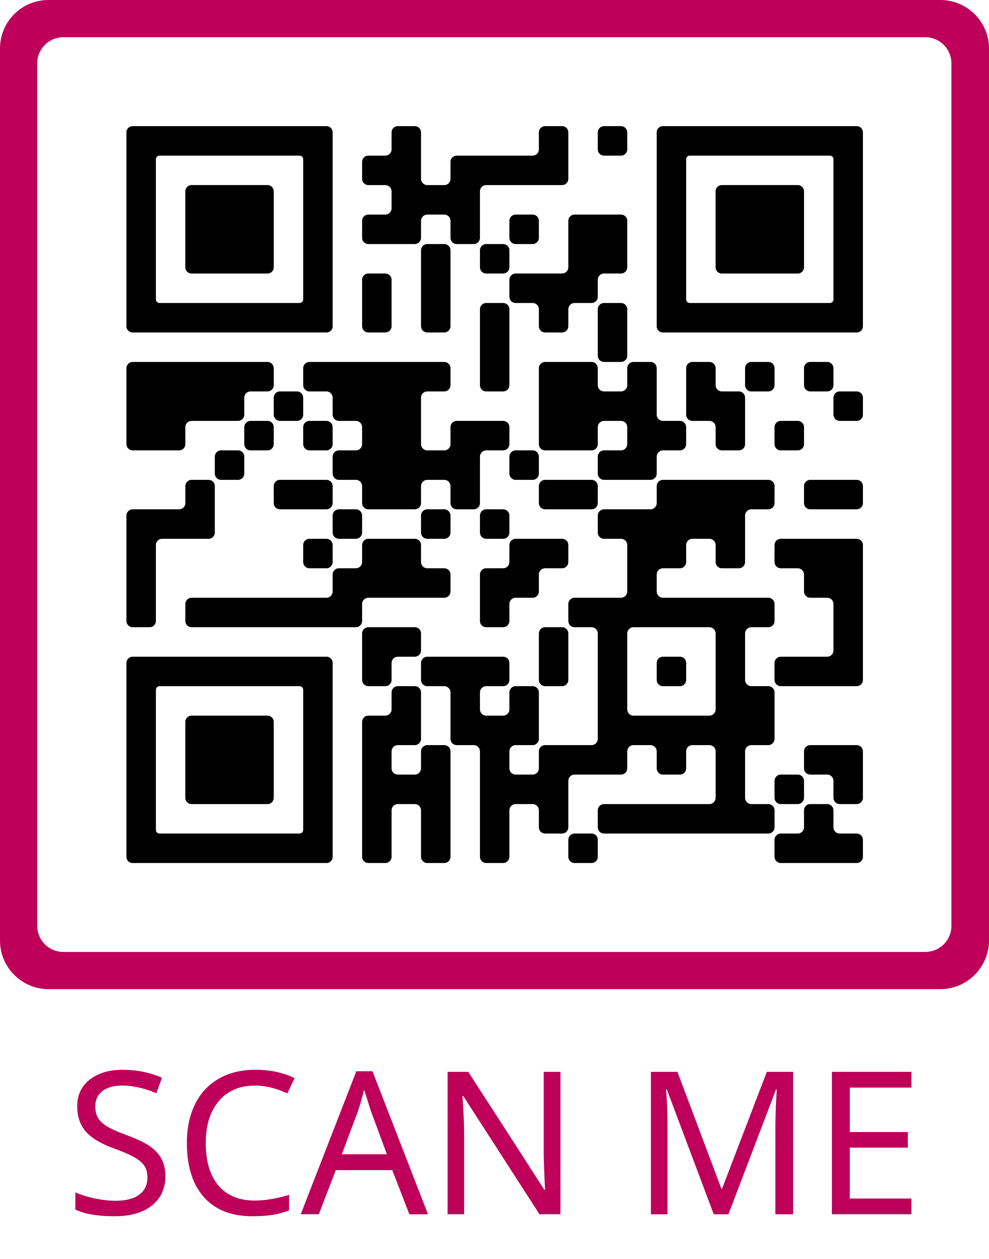

Stay Informed
AVS BASICS
Website:
Best Way to Access all AVS Benefits and Activities
How to Contact Us
E-Mail Lists:
Managing Your Subscription
Newsletters:
Beneath the Surface
FYI Science Policy
Member Checklist
President’s Message
Job Opportunities and Career Services
Social Media:
Follow Us for Daily Updates and to Engage with Colleagues
How AVS Stays in Touch
Scan to Access the AVS Website and to Follow Us on Social Media

Slide 11






AVS BENEFITS
Awards & Recognition
Events
Publications Library
Major & Graduate Student Awards Chapters, Groups, and Divisions Awards Travel Grants
Member Registration Discounts International Symposia Sponsored & Endorsed Events Chapter, Group, Division Events Short Courses, Webinars, e-Talks
Five Publications: AQS - Biointerphases - JVST A - JVST B - SSS
Technical Library
Professional Development
Career Services
Conference Presentations e-Talks and Webinars Other Technical Resources
Early Career and Student Activities Technical and Career Development Webinars and Resources
Job Postings Career Related Articles, Resources, and Videos

Slide 12

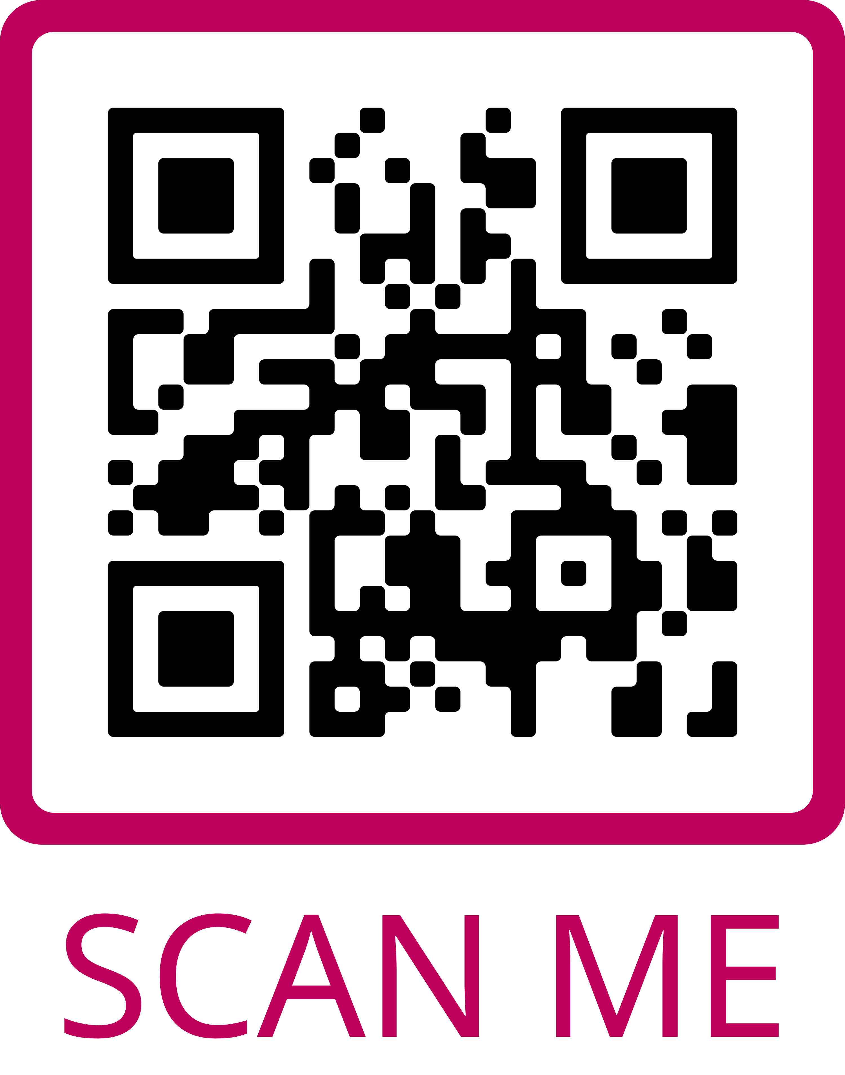
Awards & Recognition
AVS BENEFITS
Awards & Recognitions Opportunities:
Medard W. Welch Award
John A. Thornton Award
Gaede-Langmuir Award
Peter Mark Award
George T. Hanyo Award
Fellows – 5 Years Continuous Membership
Honorary Membership
National Student Awards
Division and Group Awards
Mentor Recognition
Travel Grants
Receive for Your Accomplishments or Nominate a Peer or Colleague
Scan to Access a Complete List of AVS Awards & Recognitions and to View Current and Past Awardees

Slide 13

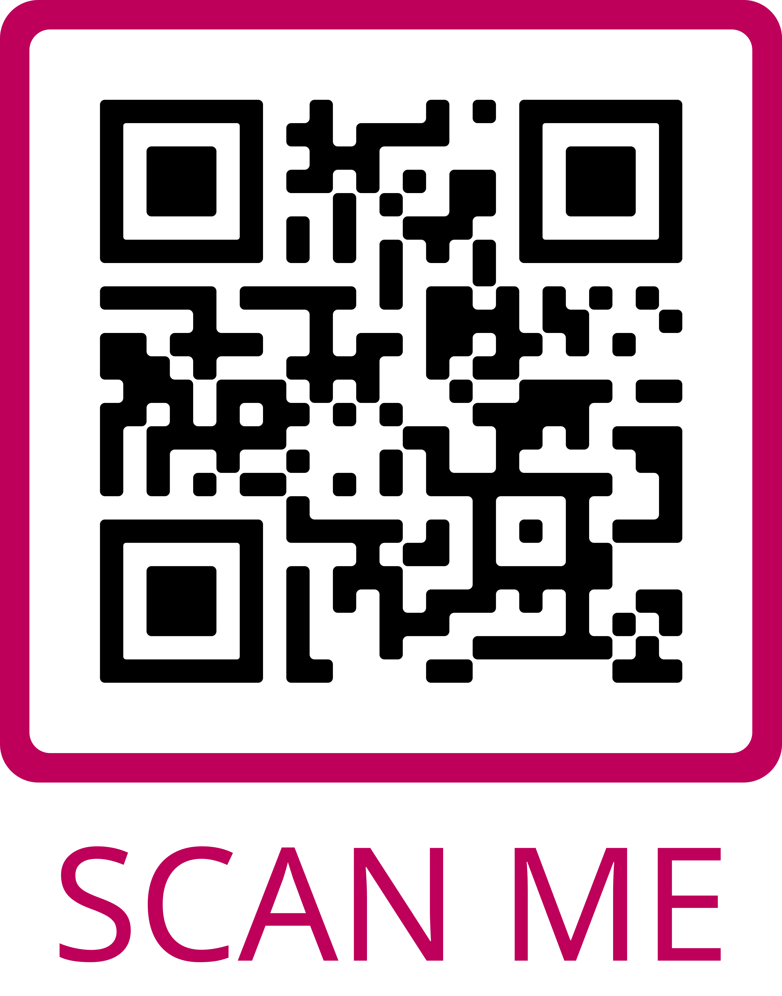
Events & Activities
AVS BENEFITS
AVS Promotes Sharing of Research Through a Variety of Events:
Member Discounted Events:
AVS International Symposium & Exhibition
Atomic Layer Deposition and Atomic Layer Etching Conference
AVS National Short Courses, Webinars, and e-Talks
Sponsored Topical Conferences
Endorsed Topical Conferences
Chapter, Division, and Group Events
AVS Sponsors and Endorses Many Events Each Year
Scan to Access the AVS Events Calendar

Slide 14

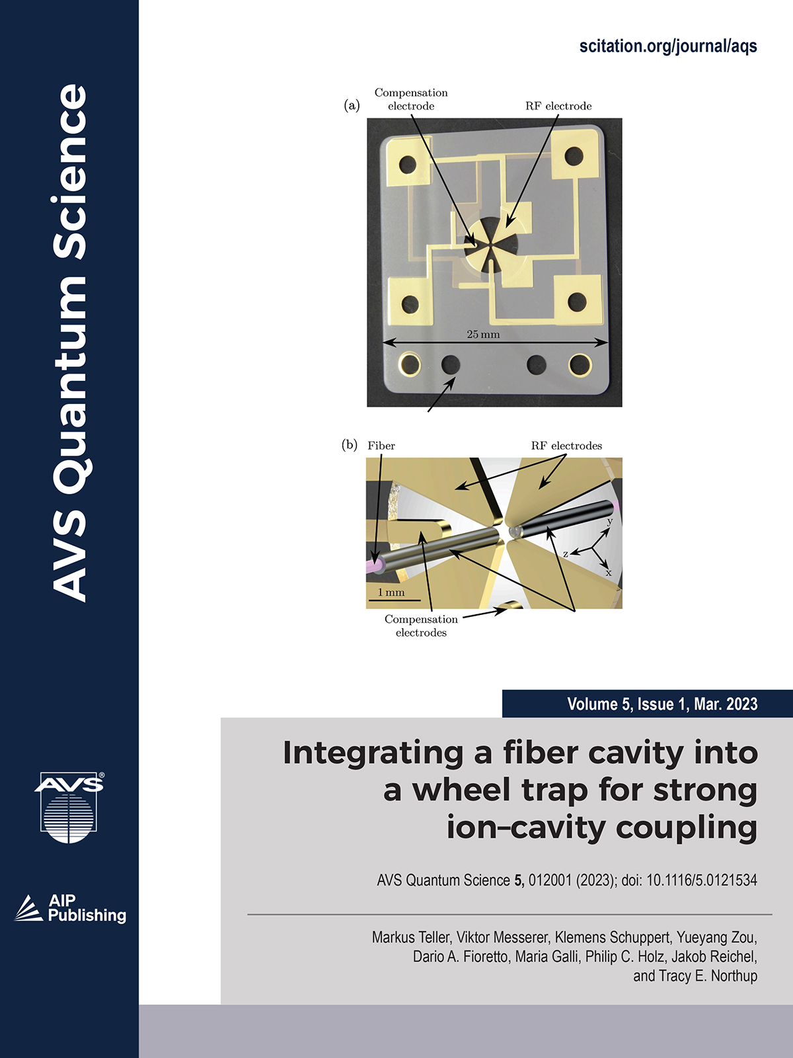
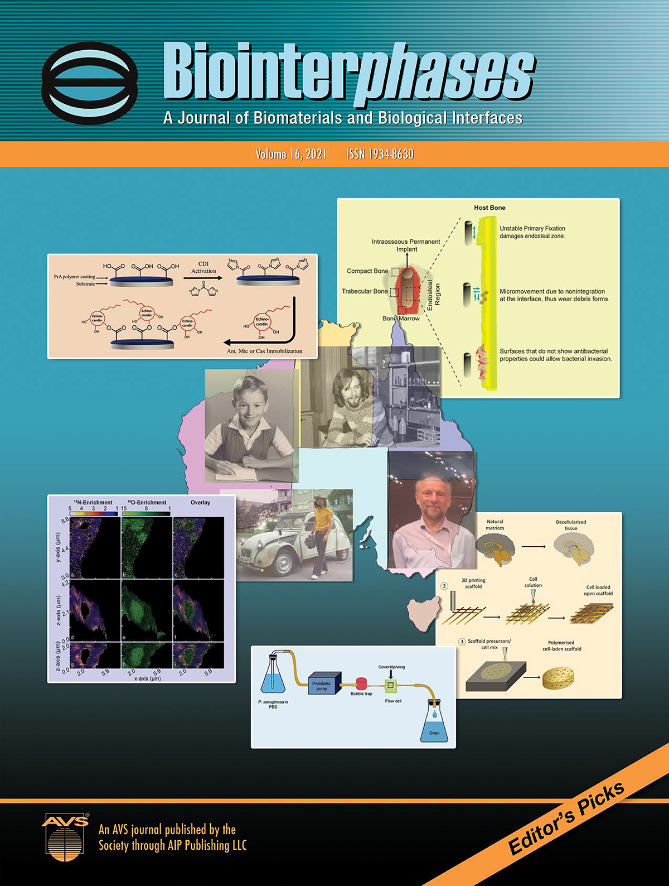
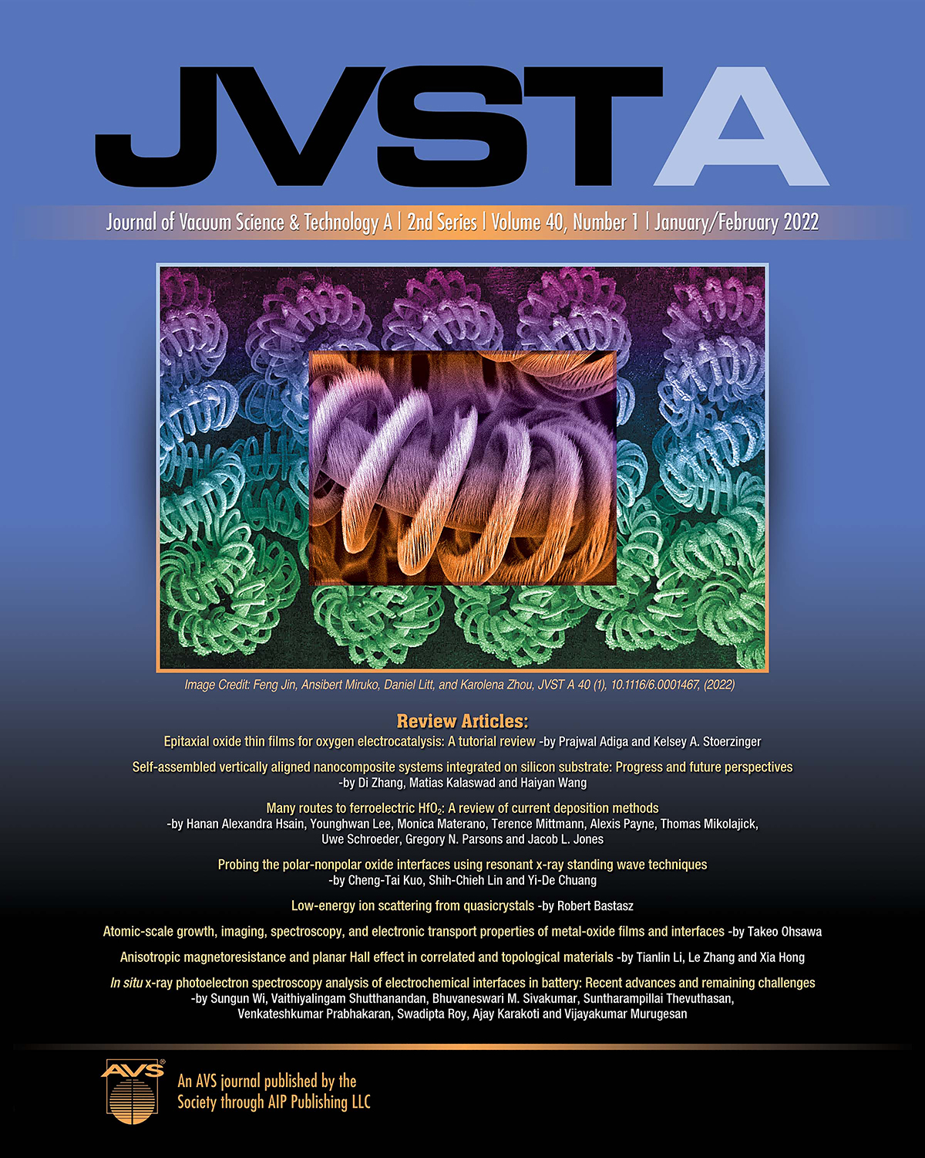
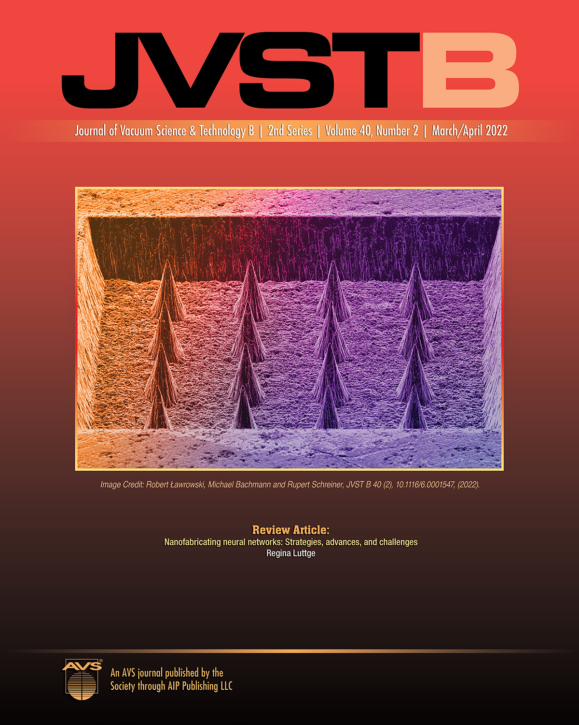
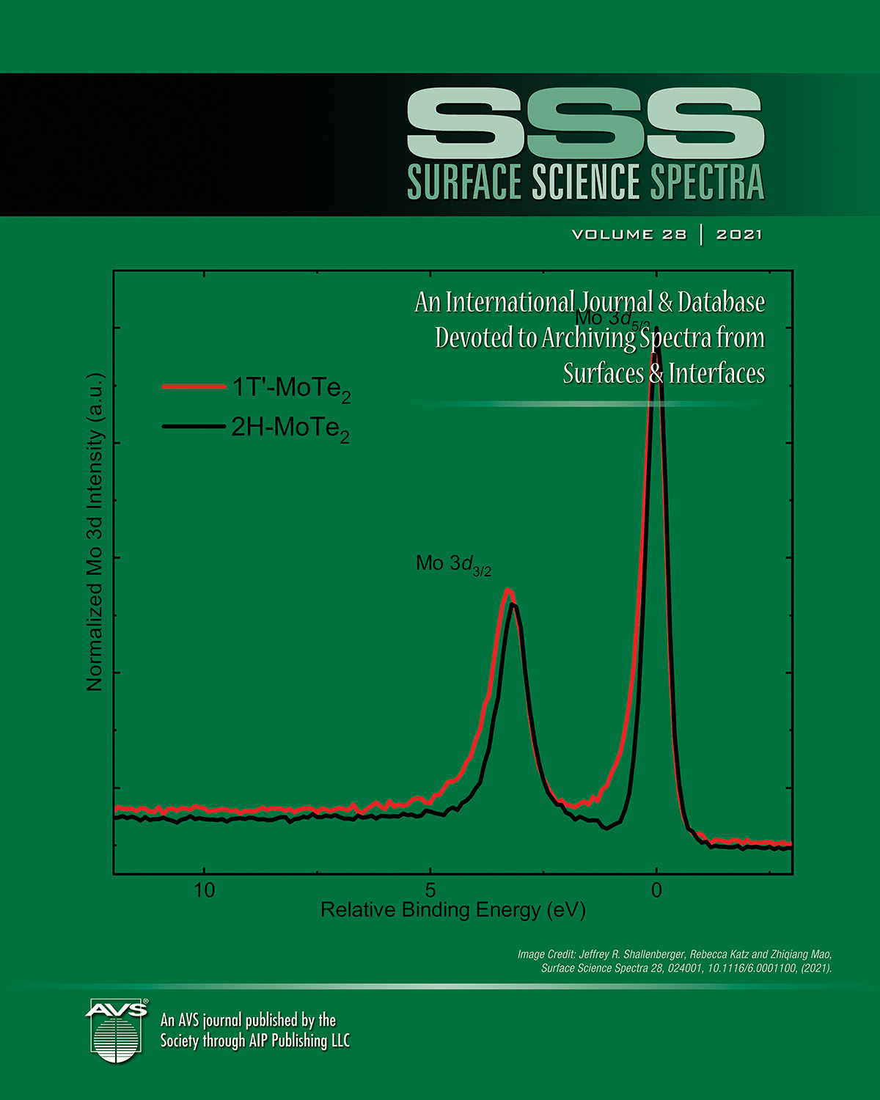
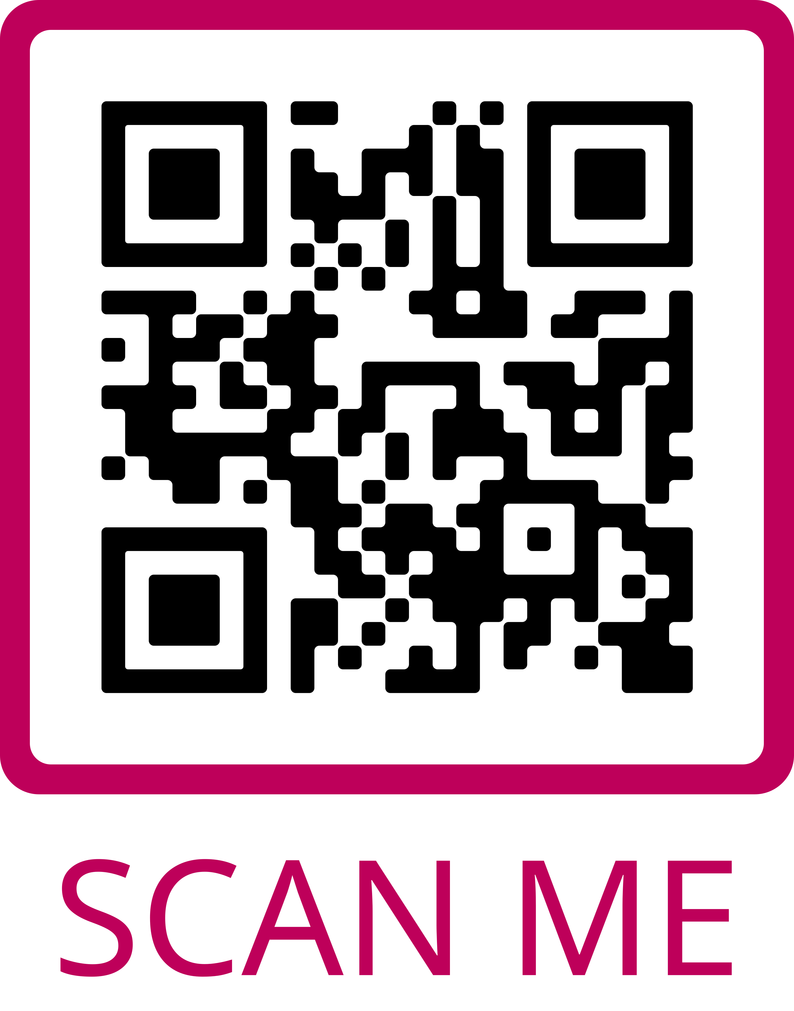
Publications Library
AVS BENEFITS
What’s in the Publications Library:
AVS Quantum Science
Biointerphases
Journal of Vacuum Science & Technology A (JVST A)
Journal of Vacuum Science & Technology B (JVST B)
Surface Science Spectra (SSS)
Visit the AVS Publications, Booth #501 in Exhibit Hall A from Tuesday-Thursday to Learn About Upcoming Special Topic Collections
Contribute or Read the Latest Research in Your Areas of Interest
Scan to Access all Five AVS Publications

Slide 15
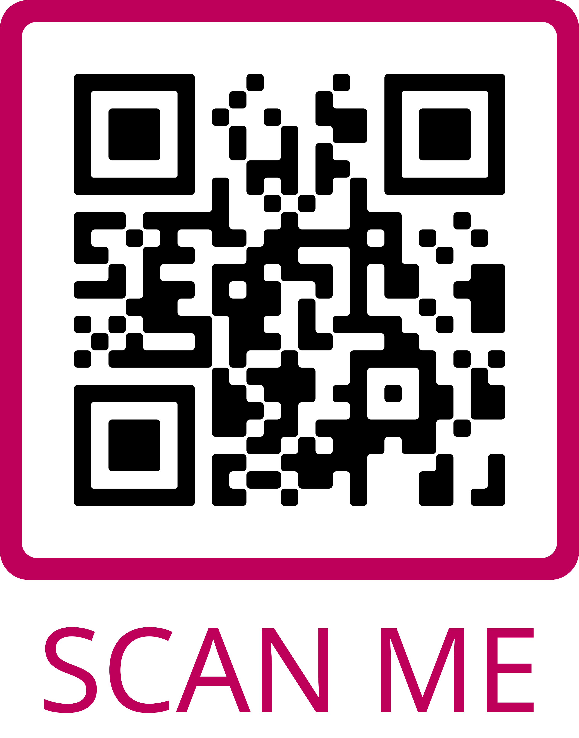
Technical Library
AVS BENEFITS
What’s in the Technical Library:
Conference Presentations
e-Talks
Monographs
Professional Development Webinars
Recommended Practices
Technical Training Webinars
Other Technical Resources
View the Latest Research in Your Areas of Interest
Scan to Access the Latest Content

Slide 16


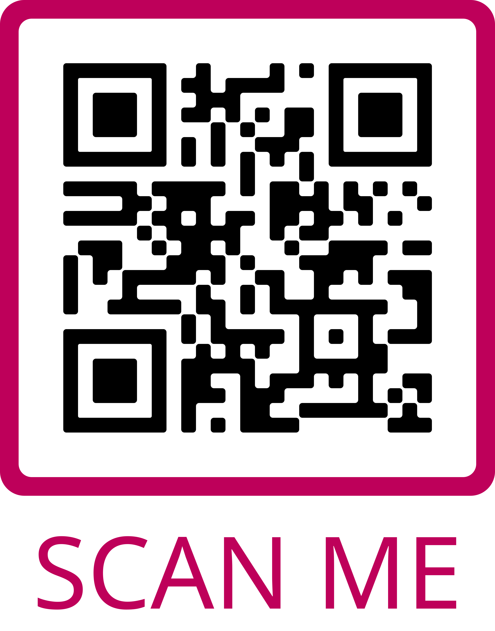
Career Services
AVS BENEFITS
Career Resources and Employment Opportunities:
Job Postings
Career Related Articles, Resources, and Videos
Webinars
Visit the AVS Career Center, Booth #801, from Tuesday-Thursday in Exhibit Hall A to Meet Recruiters and View or Post Job Listings
Your Portal for Career Resources and Advice
Scan to Access the Online Career Center Including Employment Opportunities

Slide 17

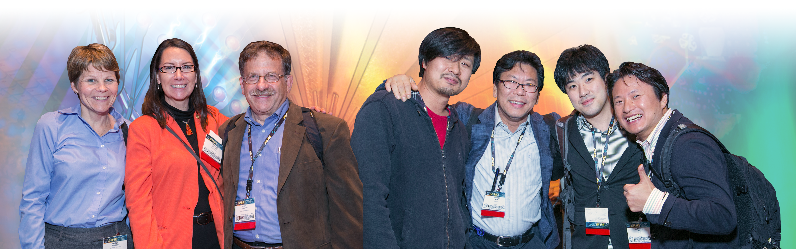
VOLUNTEER ORGANIZATION
VOLUNTEERING MEMBER STORIES

Slide 18

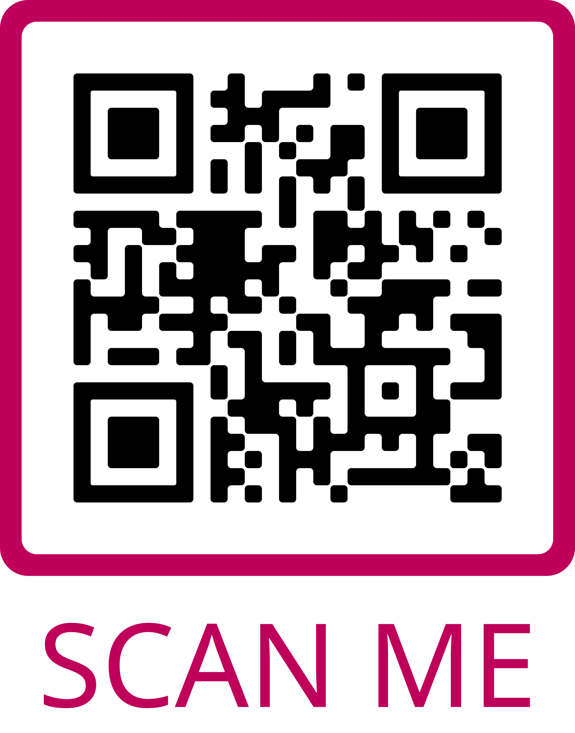
Get Involved
VOLUNTEERING & MEMBER STORIES
Volunteer Opportunities:
Develop Education Items and Training
Join a Chapter, Group, or Division Executive Committee
Preserve AVS History
Promote AVS Activities
Review Publications Articles
Serve on the AVS Board of Directors
Serve on a Program Committee
Serve on Various Committees
Work on Governance, Policies, Procedures
Show Your AVS Spirit: AVS Logo Items are For Sale this Week in the AVS Member Center
Volunteers are the Superheroes of AVS
Scan to Access and Complete the AVS Volunteer Interest Form

Slide 19



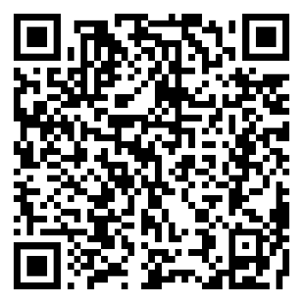
AVS Special Topic Collections
Submit your work presented to the special topic collections in AVS Quantum Science, Biointerphases, JVST A, or JVST B !
Scan to See the Open Special Topic Collections!
Learn More About Each Journal and How to Submit at avspublications.org

Slide 20
AVS Publications
Learn More About Each Journal and How to Submit at avspublications.org

Slide 21
