Slide 1
AVS BASICS
About AVS
MyAVS
Stay Informed
Governance Chapters, Groups, and Divisions
Member Profile Benefit Portal Join and Renew
Website How to Contact Us
E-mail Lists
Newsletters
Social Media
Manage Subscriptions
Beneath the Surface Member Checklist President’s Message
Follow Us

Slide 2
ABOUT AVS
AVS Basics
Volunteer Organization
Chapters, Groups, and Divisions
As an interdisciplinary, professional Society, founded in 1953, AVS supports networking among academic, industrial, government, and consulting professionals involved in a wide variety of disciplines related to materials, interfaces, and processing.
AVS is a Member Society of AIP comprised of 4,000 members worldwide.
10 Divisions
4 Technical Groups
16 Regional Chapters
2 International Chapters
9 International Affiliates
6 Student Chapters
5-8 Focus Topics/Symposia

Slide 3
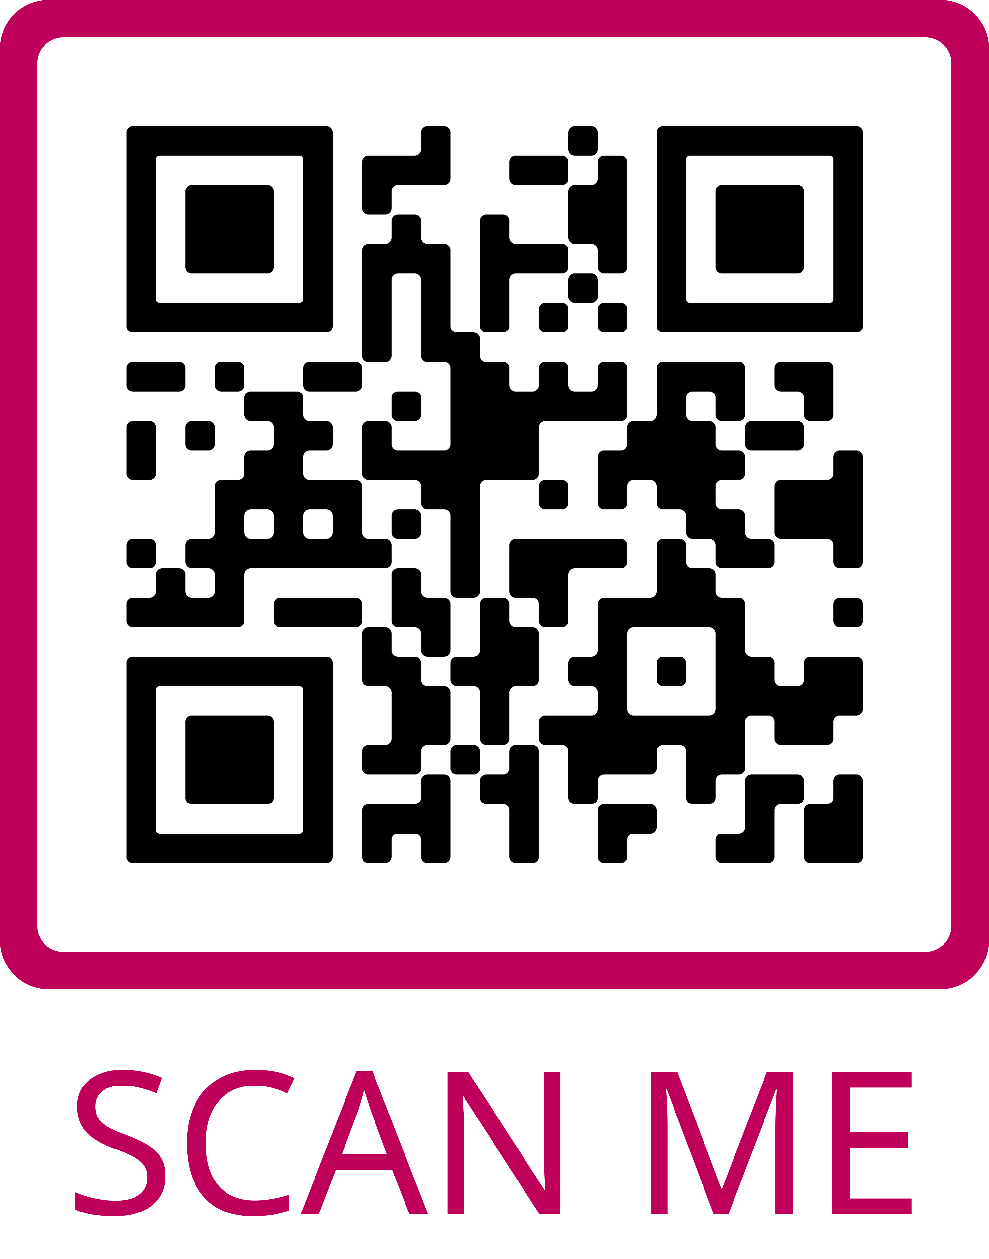
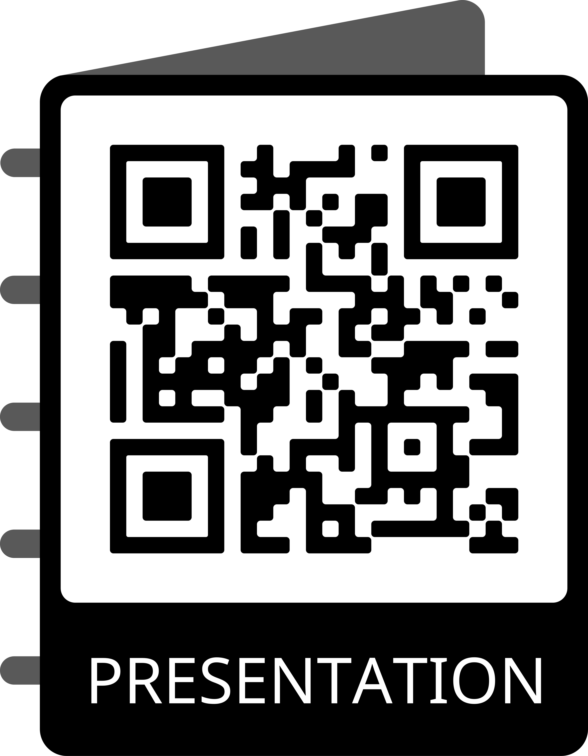
AVS BASICS
New and Improved MyAVS Featuring:
Streamlined Navigation
Cleaner Look and Feel
Simpler Social Media Engagement
Login to MyAVS to:
Join or Renew Online - Print Receipts or Invoices
Maintain Your Profile - Add Your Photo, If Desired
Access and Print Membership Card
Reset Your Password or Request Your Username in Real Time
View New Member Tips
Access the Publications and Technical Libraries
Review Chapter and Division Affiliations
Look for the Latest Insurance and Long-Term Care Discounts
Purchase Official AVS Merchandise
Features Coming in 2025: Online Communities + More
Your Portal to All AVS Member Benefits
Scan to Access MyAVS
Scan to View This Presentation

Slide 4
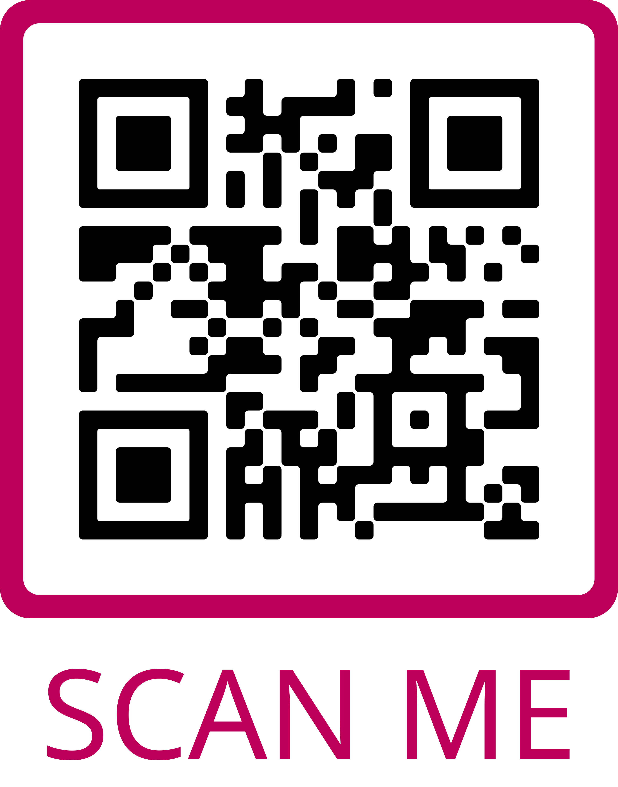
Stay Informed
AVS BASICS
Website:
Best Way to Access all AVS Benefits and Activities
How to Contact Us
E-Mail Lists:
Managing Your Subscription
Newsletters:
Beneath the Surface
FYI Science Policy
Member Checklist
President’s Message
Job Opportunities and Career Services
Social Media:
Follow Us for Daily Updates and to Engage with Colleagues
How AVS Stays in Touch
Scan to Access the AVS Website and to Follow Us on Social Media

Slide 5
AVS BENEFITS
Awards & Recognition
Events
Publications Library
Major & Graduate Student Awards Chapters, Groups, and Divisions Awards Travel Grants
Member Registration Discounts International Symposia Sponsored & Endorsed Events Chapter, Group, Division Events Short Courses, Webinars, e-Talks
Five Publications: AQS - Biointerphases - JVST A - JVST B - SSS
Technical Library
Professional Development
Career Services
Conference Presentations e-Talks and Webinars Other Technical Resources
Early Career and Student Activities Technical and Career Development Webinars and Resources
Job Postings Career Related Articles, Resources, and Videos

Slide 6
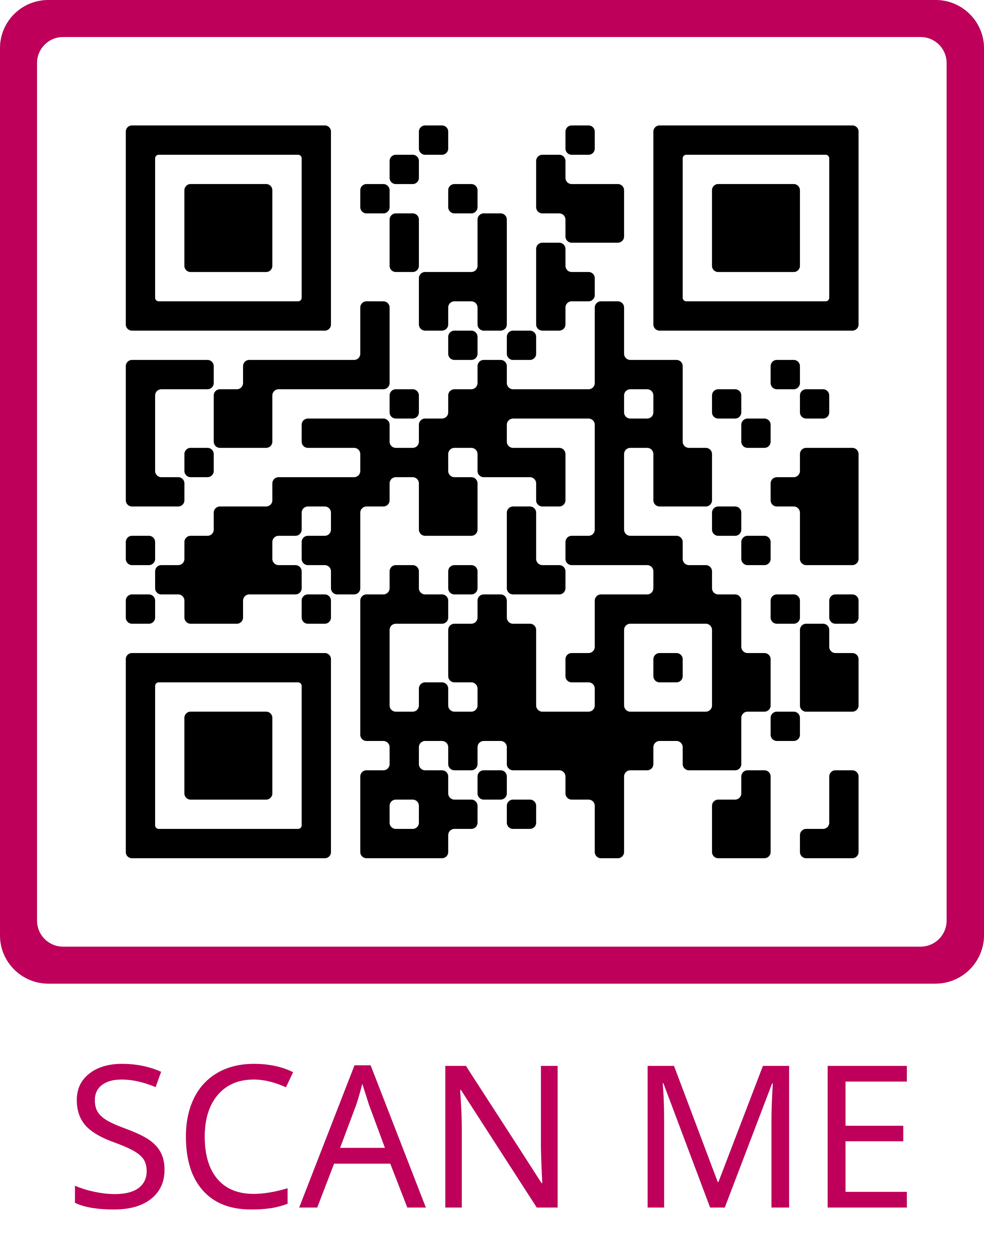
Awards & Recognition
AVS BENEFITS
Awards & Recognitions Opportunities:
Medard W. Welch Award
John A. Thornton Award
Gaede-Langmuir Award
Peter Mark Award
George T. Hanyo Award
Fellows – 5 Years Continuous Membership
Honorary Membership
National Student Awards
Division and Group Awards
Mentor Recognition
Travel Grants
Receive for Your Accomplishments or Nominate a Peer or Colleague
Scan to Access a Complete List of AVS Awards & Recognitions and to View Current and Past Awardees

Slide 7
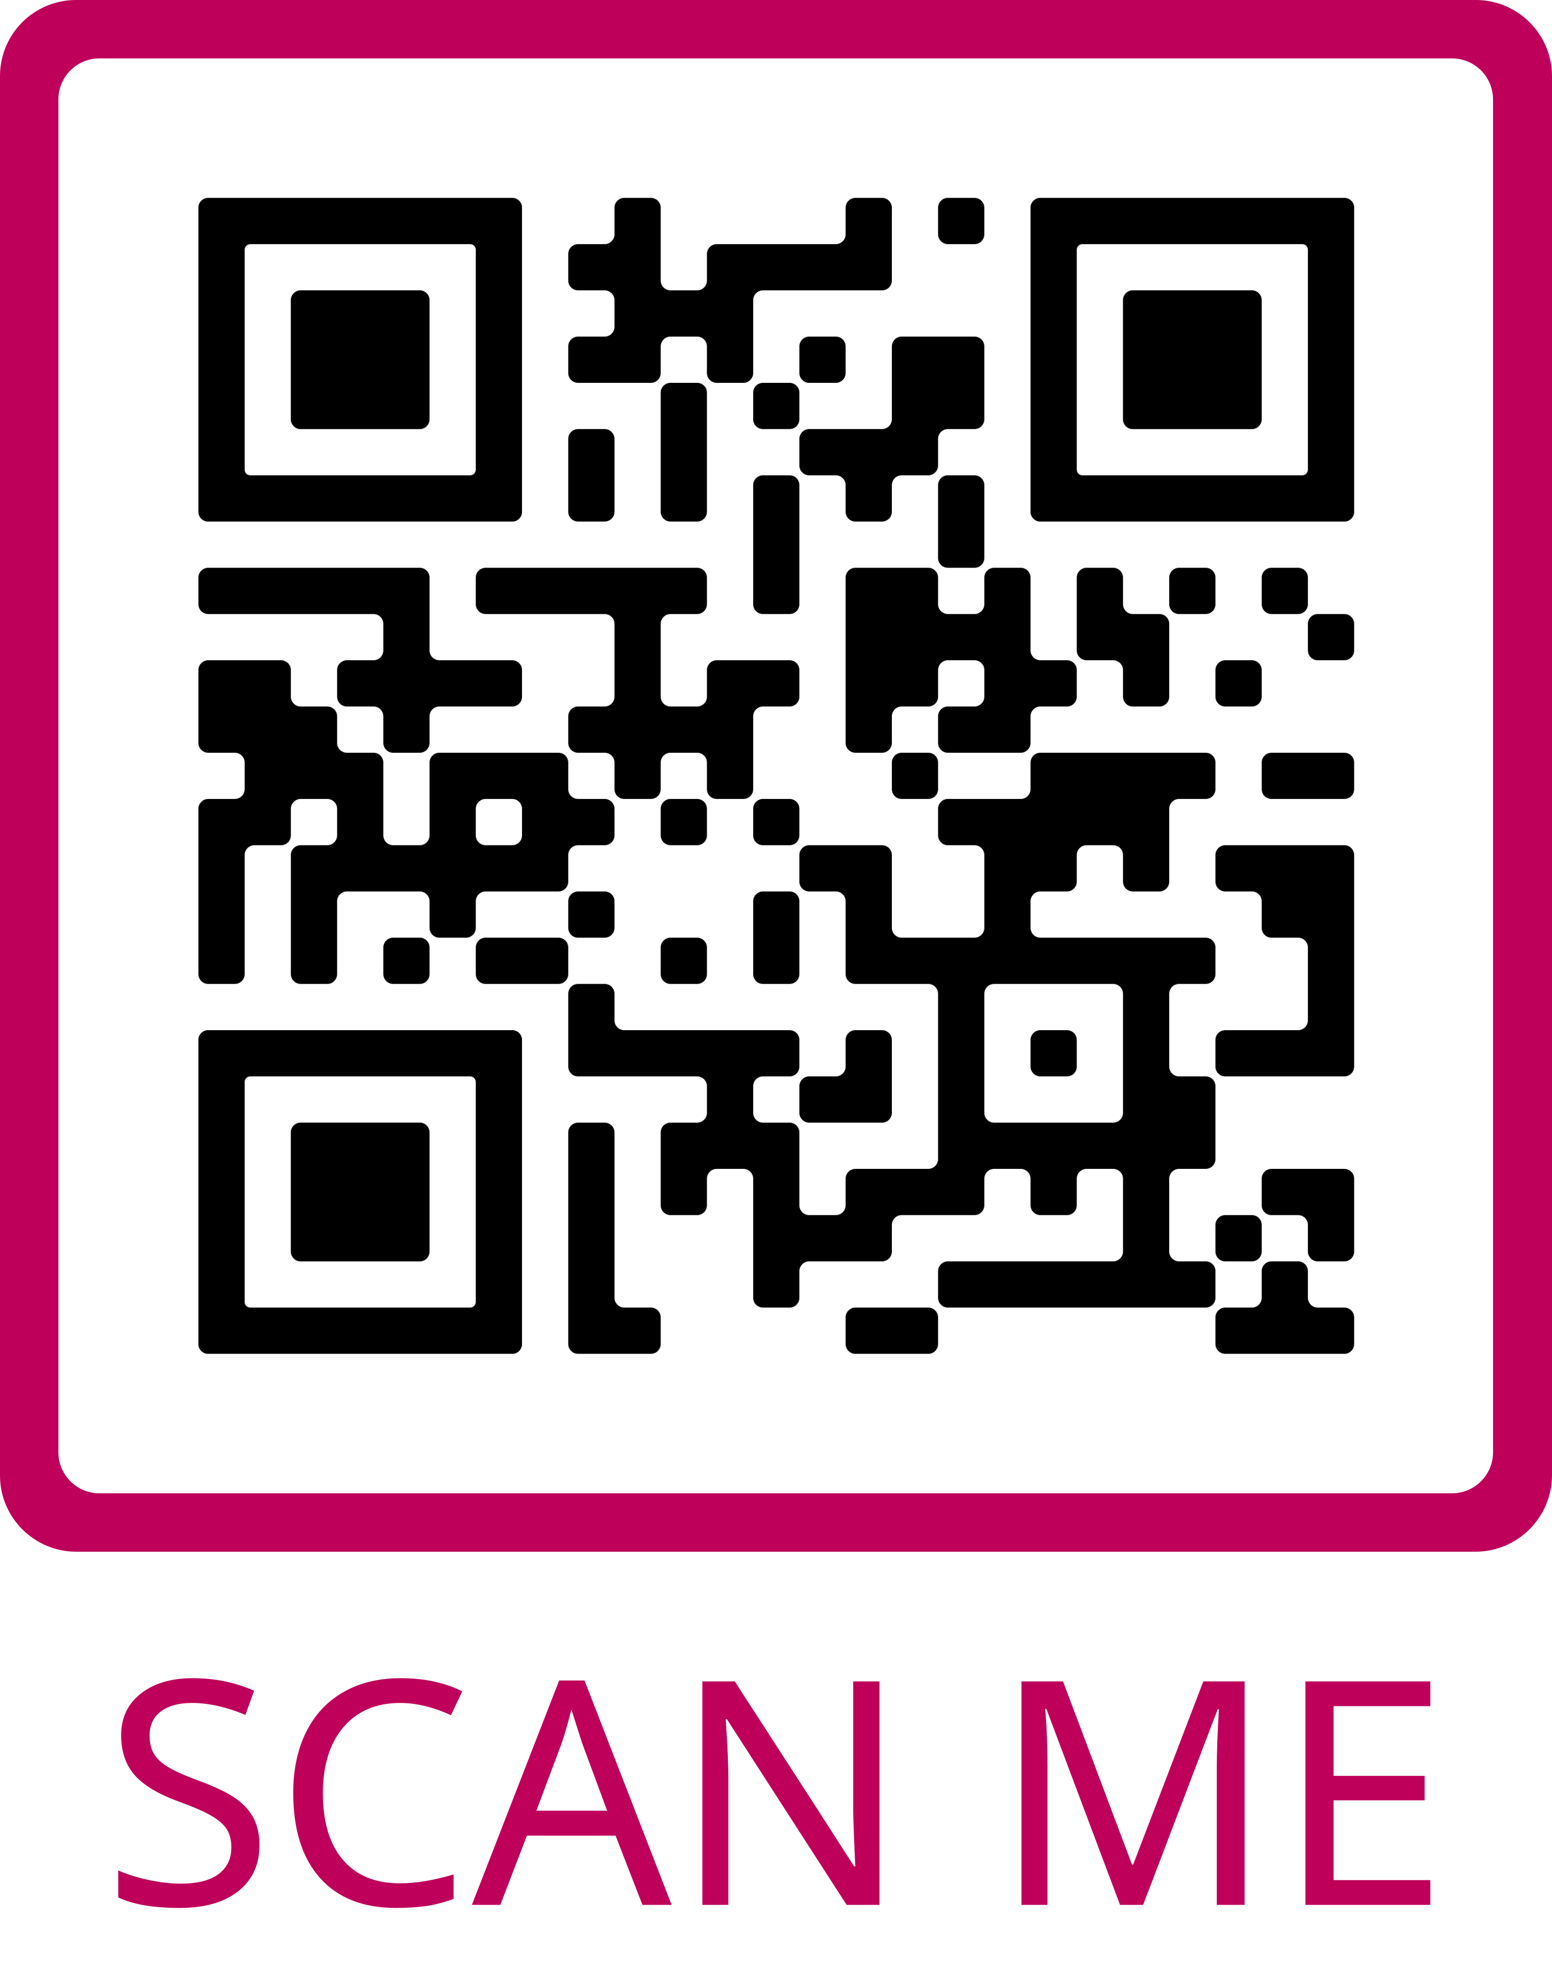
Events & Activities
AVS BENEFITS
AVS Promotes Sharing of Research Through a Variety of Events:
Member Discounted Events:
AVS International Symposium & Exhibition
Atomic Layer Deposition and Atomic Layer Etching Conference
AVS National Short Courses, Webinars, and e-Talks
Sponsored Topical Conferences
Endorsed Topical Conferences
Chapter, Division, and Group Events
AVS Sponsors and Endorses Many Events Each Year
Scan to Access the AVS Events Calendar

Slide 8
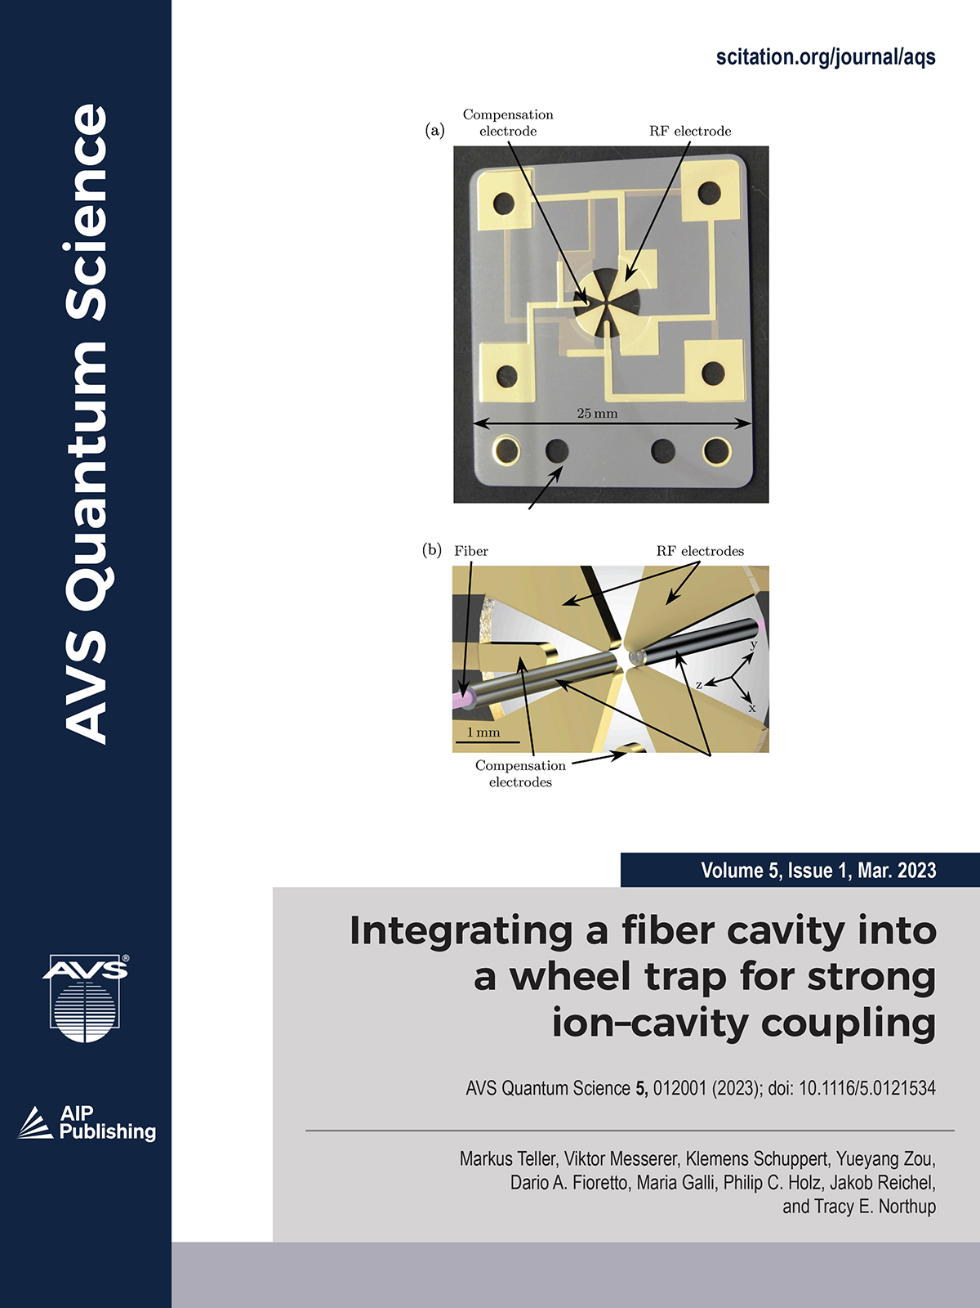
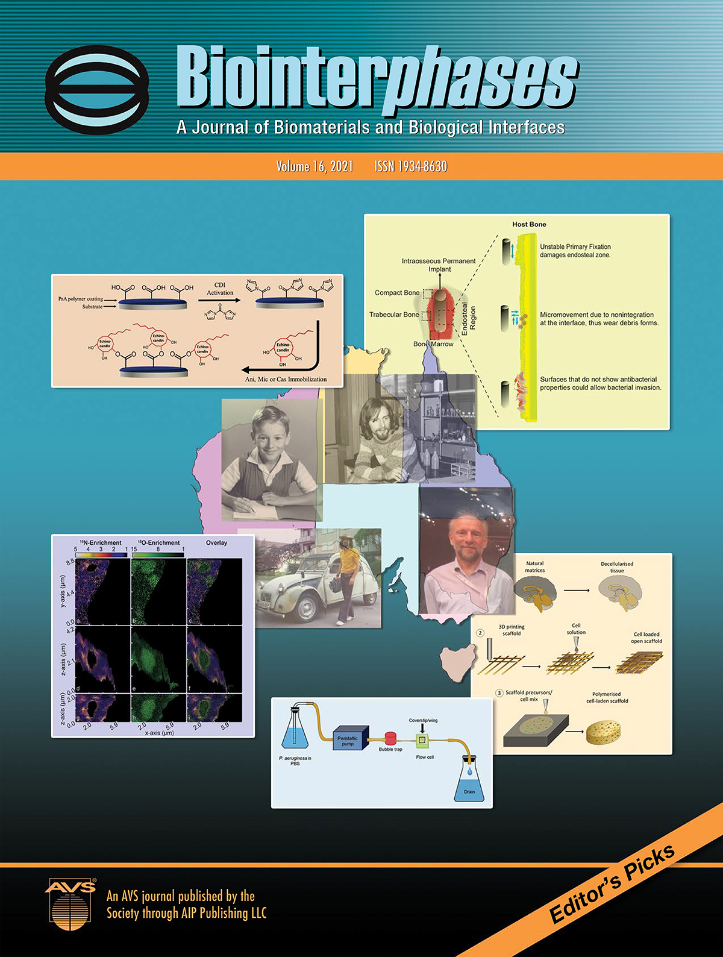
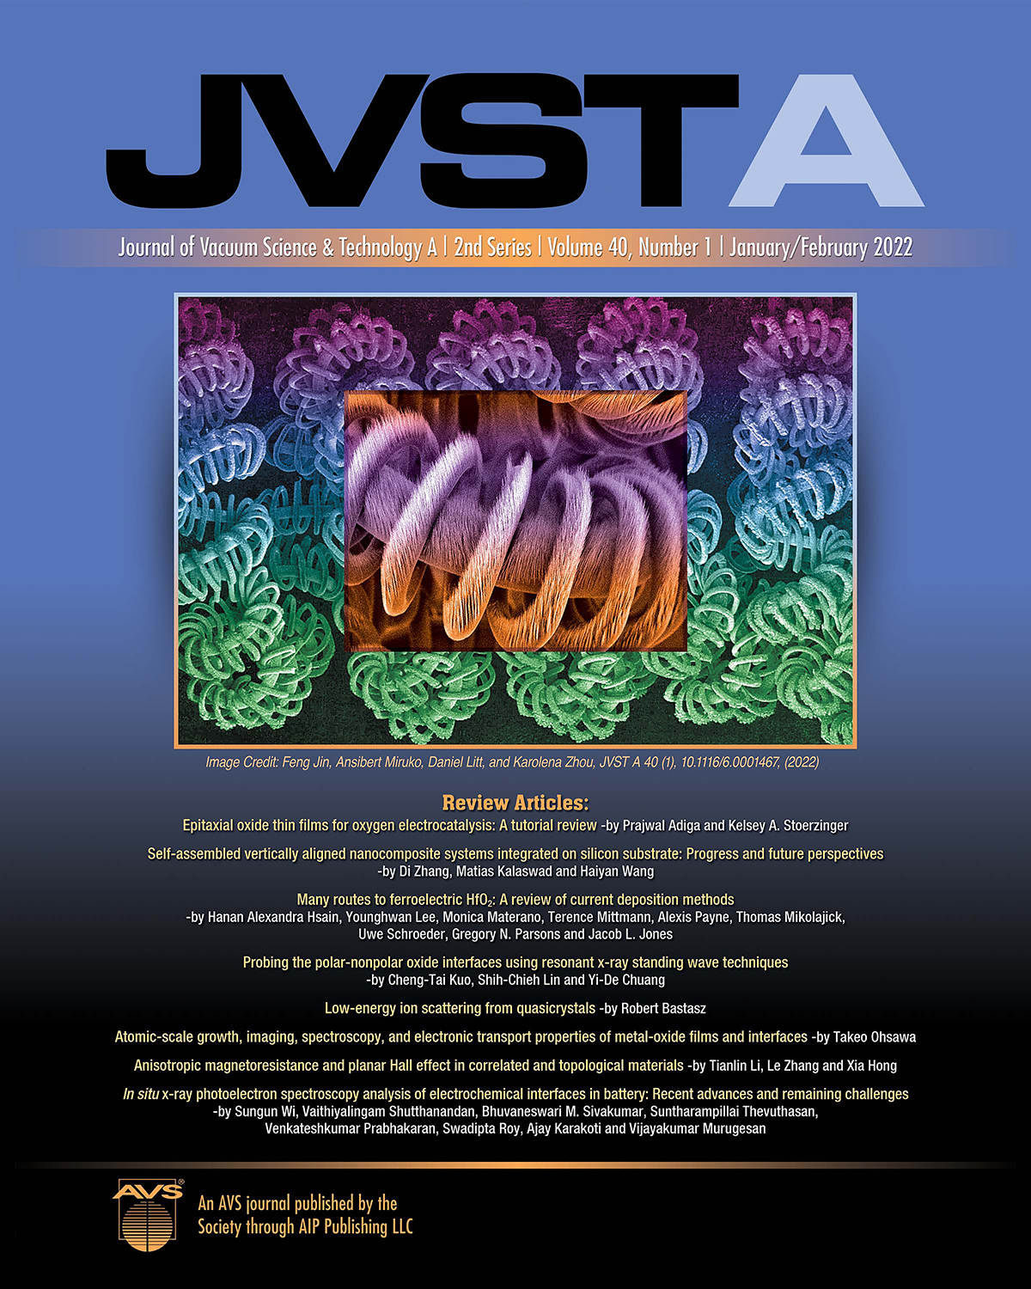
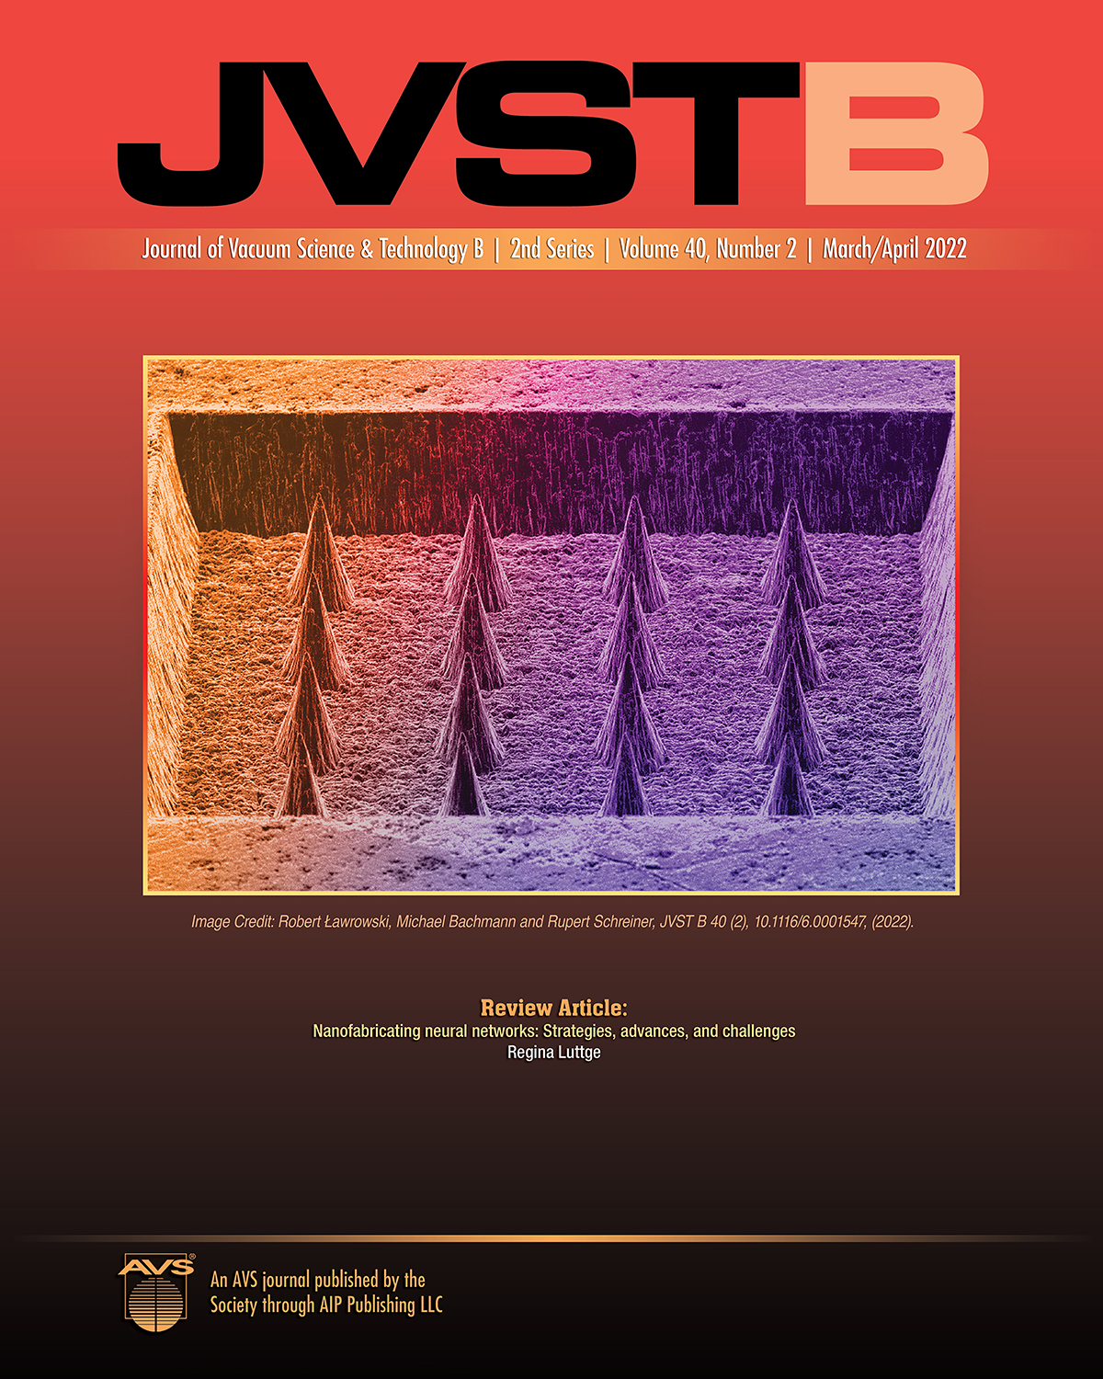
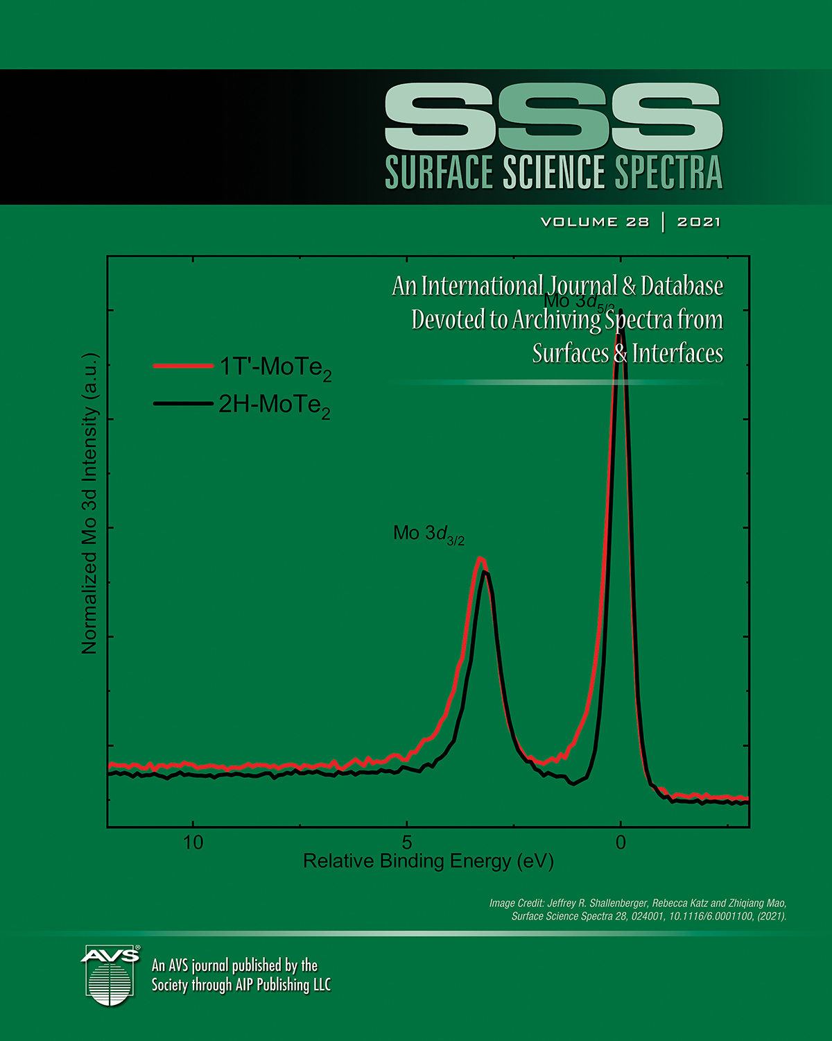
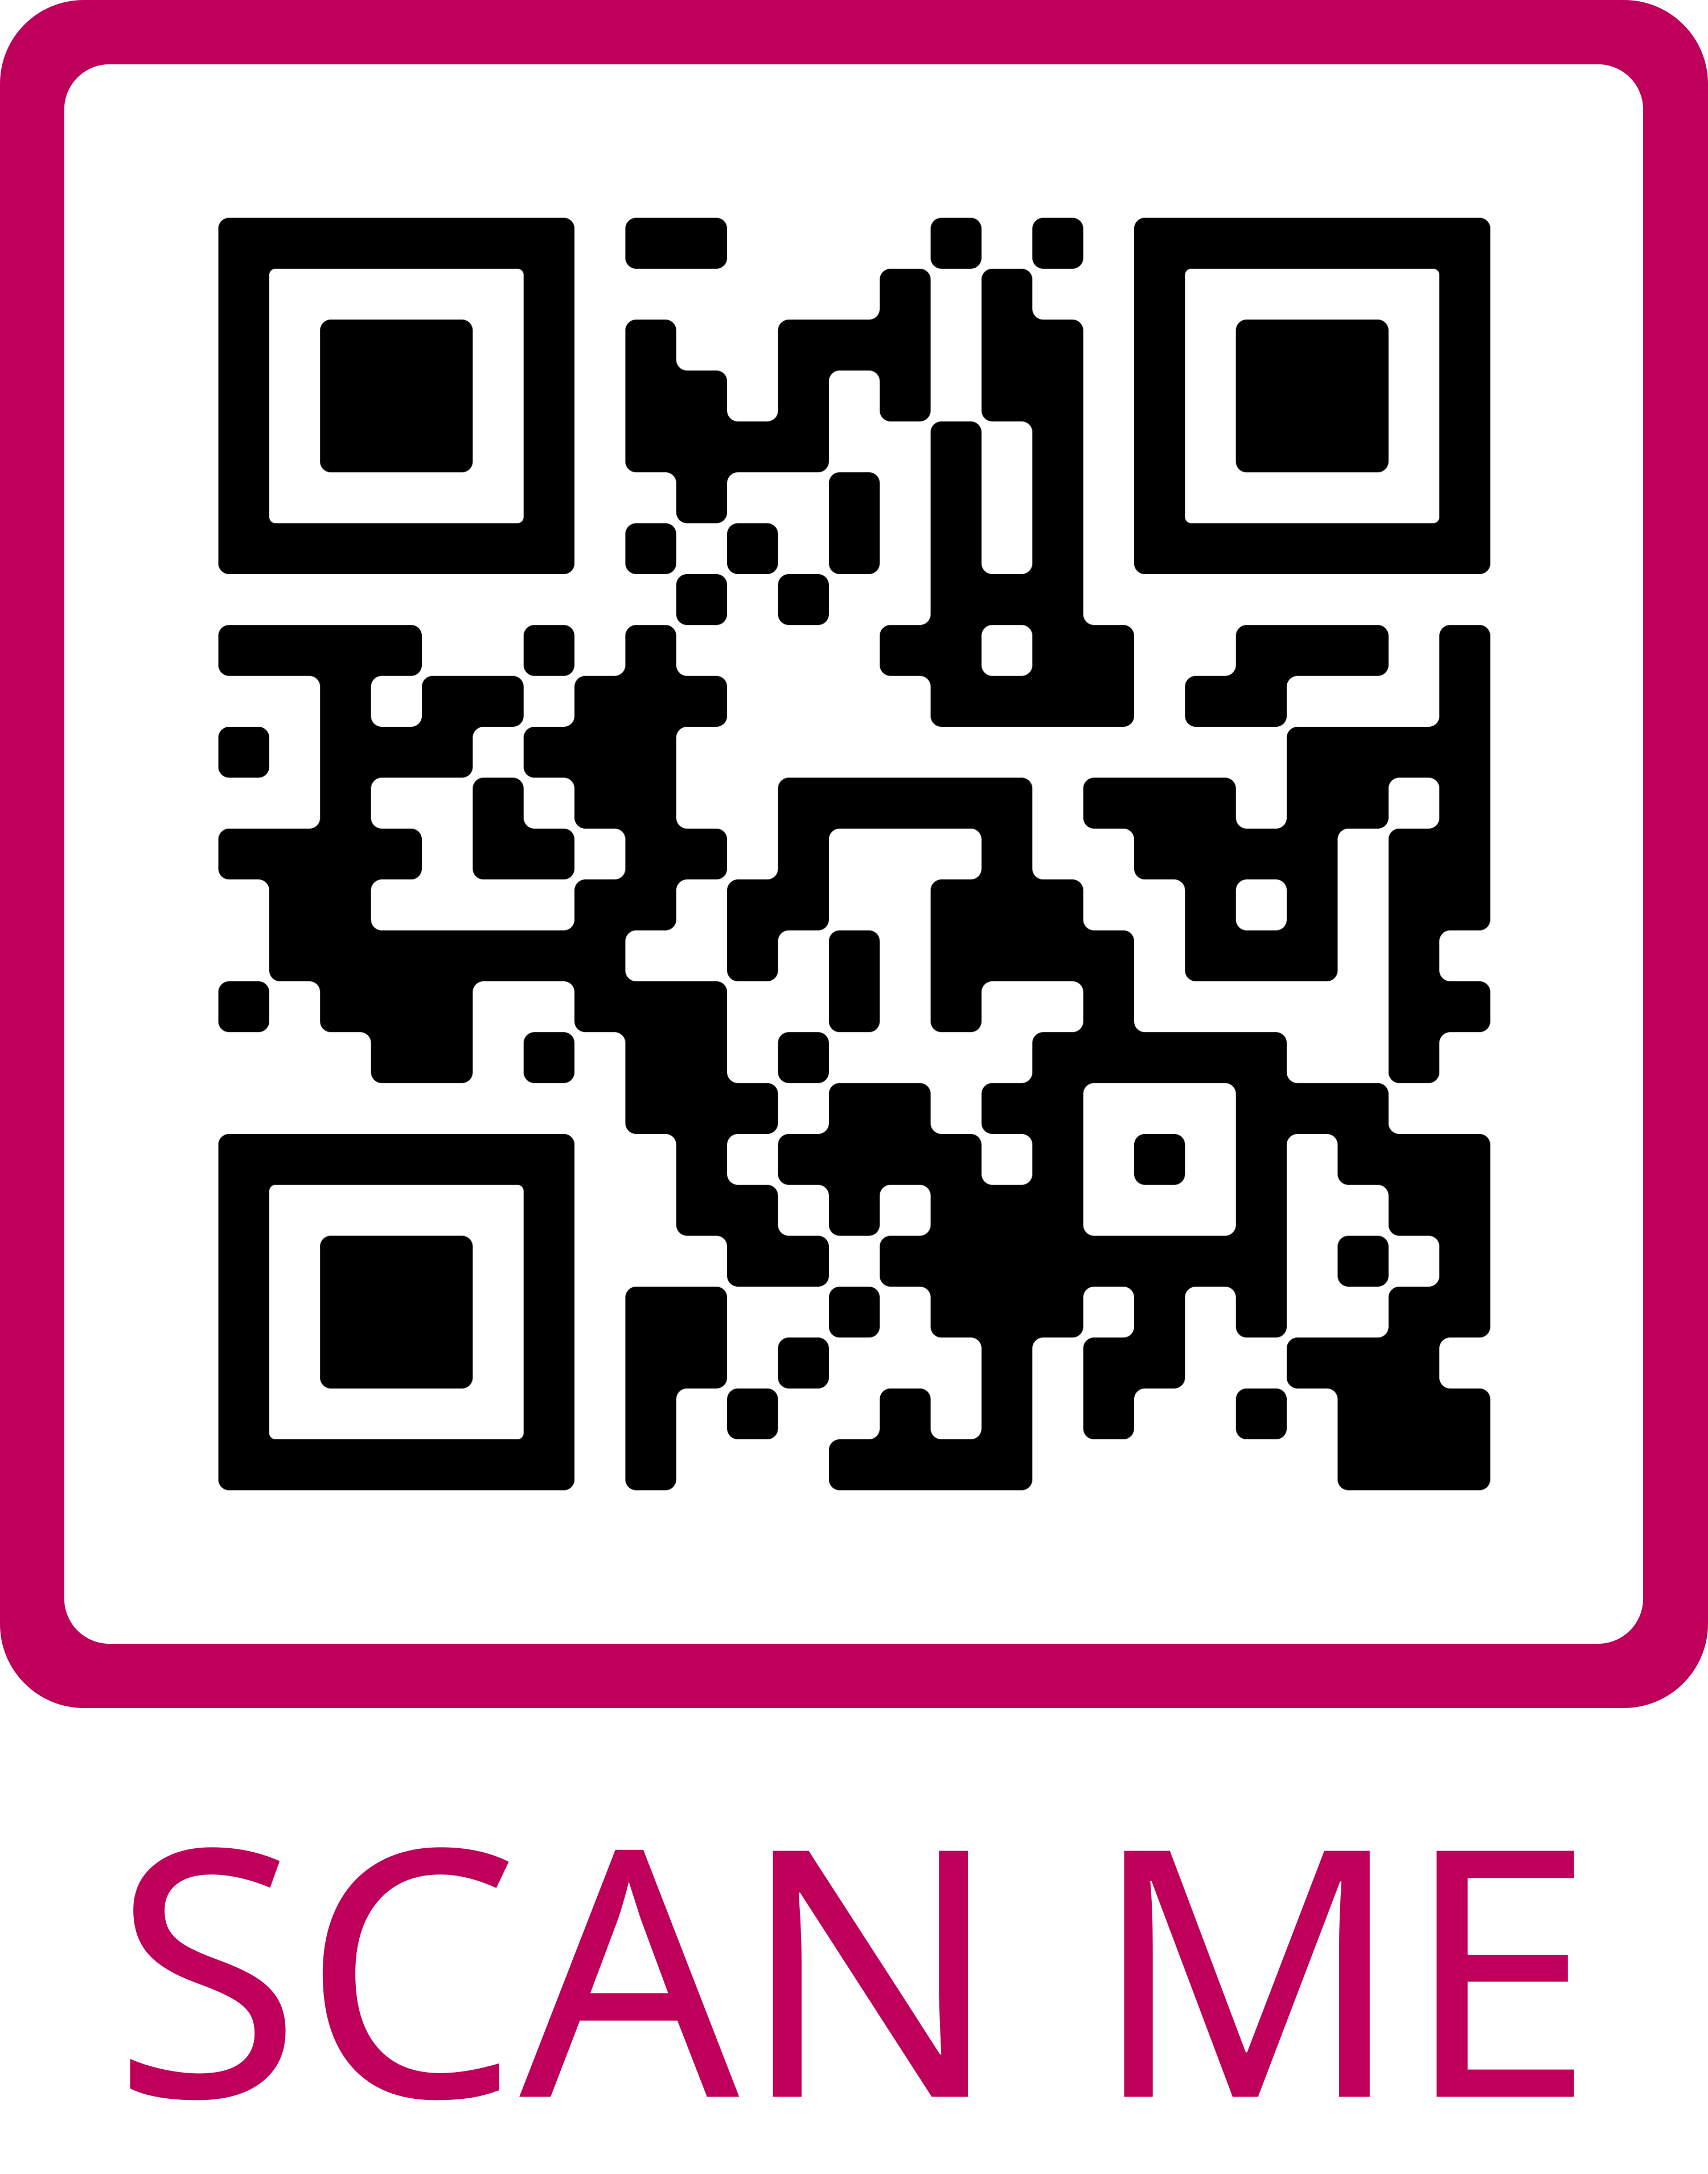
Publications Library
AVS BENEFITS
What’s in the Publications Library:
AVS Quantum Science
Biointerphases
Journal of Vacuum Science & Technology A (JVST A)
Journal of Vacuum Science & Technology B (JVST B)
Surface Science Spectra (SSS)
Contribute or Read the Latest Research in Your Areas of Interest
Scan to Access all Five AVS Publications

Slide 9
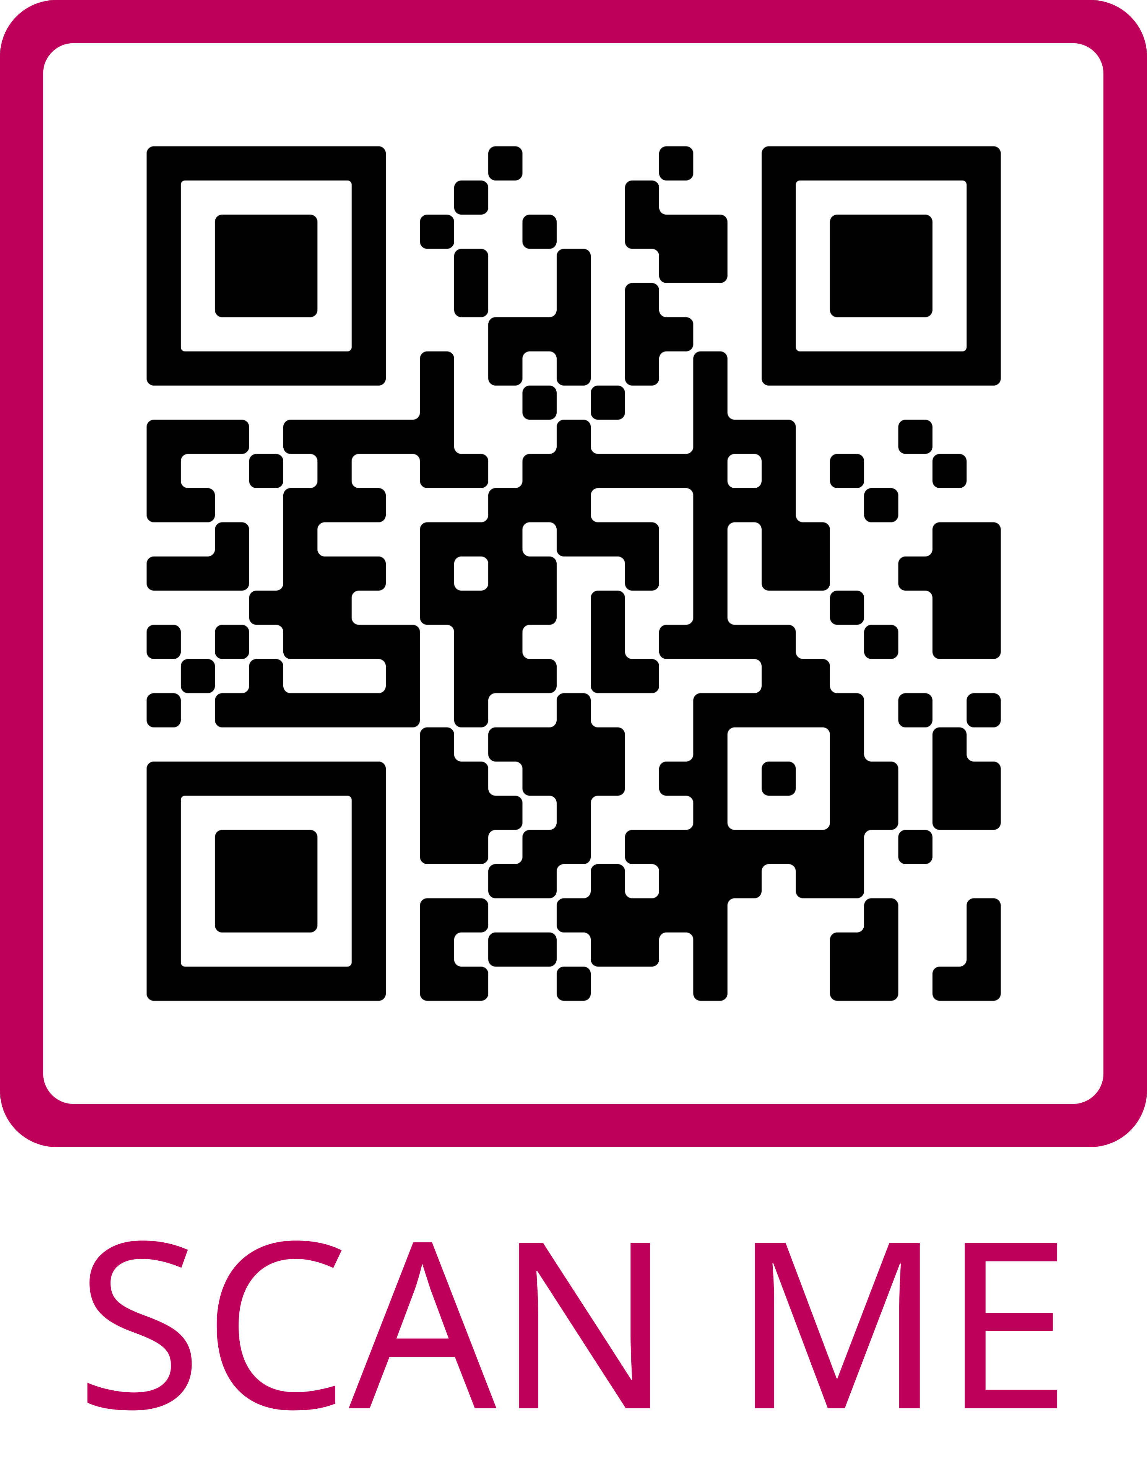
Technical Library
AVS BENEFITS
What’s in the Technical Library:
Conference Presentations
e-Talks
Monographs
Professional Development Webinars
Recommended Practices
Technical Training Webinars
Other Technical Resources
View the Latest Research in Your Areas of Interest
Scan to Access the Latest Content

Slide 10
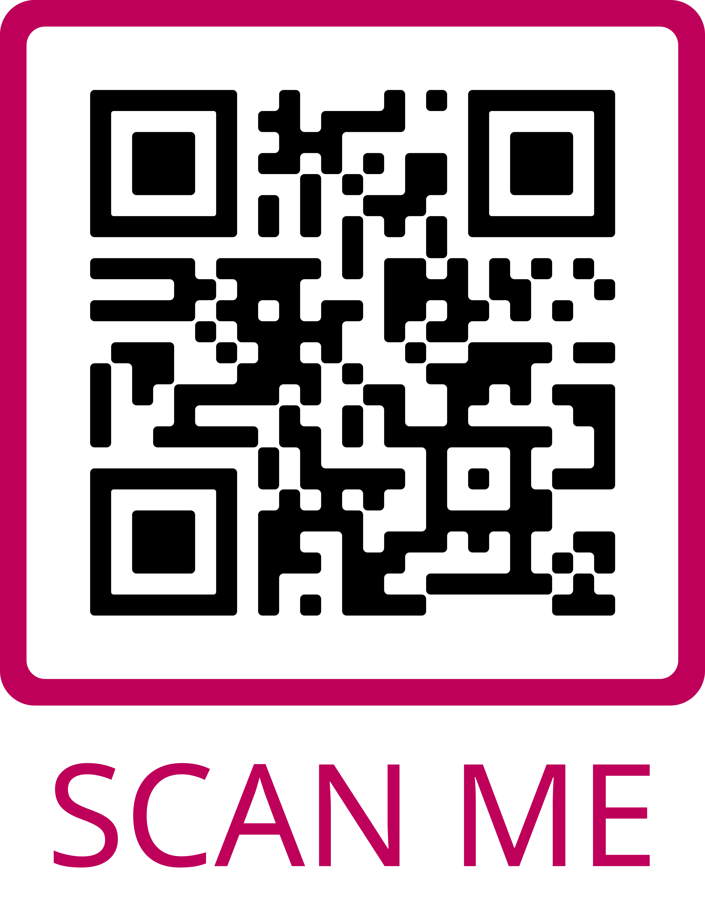
Career Services
AVS BENEFITS
Career Resources and Employment Opportunities:
Job Postings
Career Related Articles, Resources, and Videos
Webinars
Your Portal for Career Resources and Advice
Scan to Access the Online Career Center Including Employment Opportunities

Slide 11
VOLUNTEER ORGANIZATION
VOLUNTEERING MEMBER STORIES

Slide 12
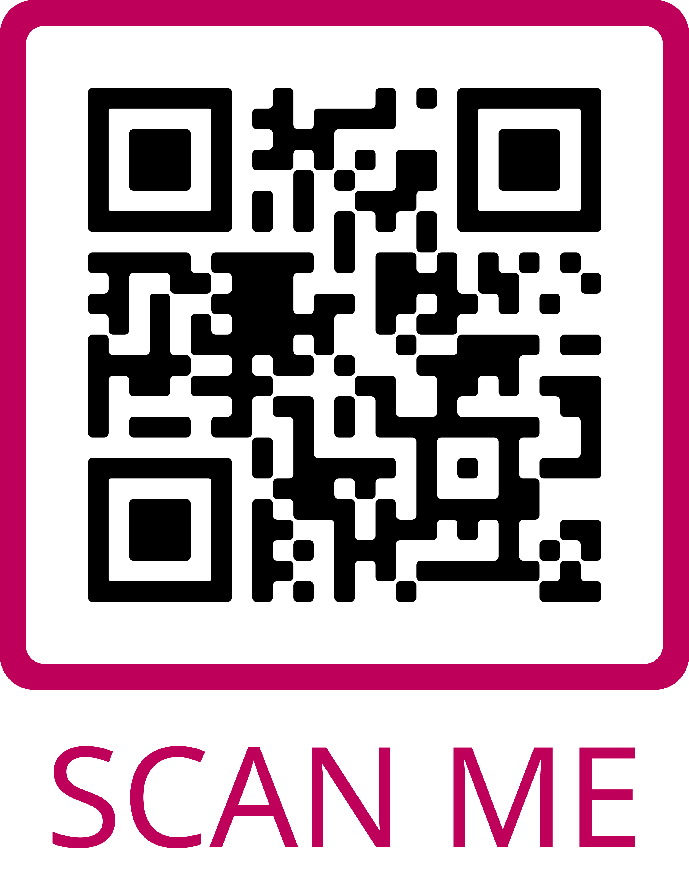
Get Involved
VOLUNTEERING MEMBER STORIES
Volunteer Opportunities:
Develop Education Items and Training
Join a Chapter, Group, or Division Executive Committee
Preserve AVS History
Promote AVS Activities
Review Publications Articles
Serve on the AVS Board of Directors
Serve on a Program Committee
Serve on Various Committees
Work on Governance, Policies, Procedures
Volunteers are the Superheroes of AVS
Scan to Access and Complete the AVS Volunteer Interest Form

Slide 13
About AVS
Website: www.avs.org
AVS is an interdisciplinary, professional Society with 4,000 members worldwide, which supports networking among academic, industrial, government, and consulting professionals involved in a variety of disciplines - chemistry, physics, biology, mathematics, all engineering disciplines, business, sales, etc. through common interests related to the basic science, technology development, and commercialization of materials, interfaces, and processing. AVS is organized into technical divisions and technical groups that encompass a range of established as well as emerging science and technology areas.
There are also regional chapters, international chapters and affiliates, and student chapters that promote communication and networking for professionals and students within a geographical region.

Slide 14
Why AVS?
Website: www.avs.org
Highly multidisciplinary: multiple divisions, technical groups, and focus topics. All research areas are covered!
As you change jobs or roles, you do not have to change societies, you can just change affiliations within AVS.
AVS is a collaborative and inclusive society.
Colleagues will give you honest feedback on ideas or practices within the field.
AVS Member Benefits
AVS Symposium Benefits

Slide 15
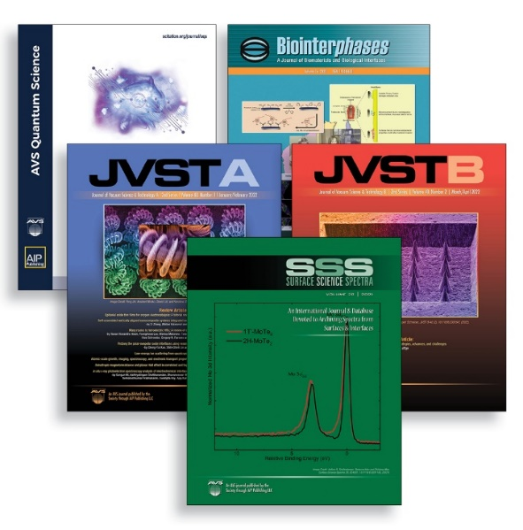
Be Part of the AVS Community
Join Us in Advancing the Science & Technology of Materials, Processing, & Interfaces
Website: www.avs.org
JVST A:
 ALD/ALE  MBE  Plasmas  Surfaces  Thin Films
JVST B:
 Electronic & Photonic Devices  Lithography  Microelectronics  Nanotechnology  Processing  Vacuum Science & Technology
Biointerphases:
Biological & Soft Matter Interfaces
Experiments, Modeling, Theory and Applications
Surface Science Spectra (SSS):
Peer Reviewed Journal & Database for Materials
High Quality Reference Spectra
NEW! AVS Quantum Science:
Quantum Biology  Quantum Communication
Quantum Computing  Quantum Devices
Quantum Materials  Quantum Measurements
Quantum Photonics  Quantum Sensors
Networking
Career Services
Training & Professional Development
Technical Conferences, Meetings, & Exhibits
Professional & Student Awards
Leadership Opportunities
Technical Resources

Slide 16
Why Join a Professional Society Like AVS?

Slide 17
AVS Membership Rates
This level is a full membership benefits package that requires payment of annual dues
$135
Platinum Full
$40
Platinum Student
Find More Membership Details at: www.avs.org/membership

Slide 18
Already an AVS Platinum Member?
Remember to Login to to Access Your Benefits
Expand Your Network
Form valuable contacts in academia, industry, and government
Collaborate with engineers, physicists, chemists, mathematicians, and biologists all working in materials, interfaces, and processing
Enhance Your Scientific & Professional Knowledge
FREE online access to JVST A, JVST B, Biointerphases, and SSS in the AVS Publications Library
International symposia and exhibitions and topical conferences
Local chapter activities and meetings
Professional development training and workshops
FREE online access to the AVS Technical Library featuring AVS Presentations on Demand, books, videos, etc.
Opportunity to Develop & Practice Your Leadership Skills
Lead or volunteer on a local, national, or international committee or division
Develop symposia programming
Participate in advocacy programs
Discounts on Subscriptions, Meeting Attendance, Hotels, Insurance, and More
Website: www.avs.org

Slide 19
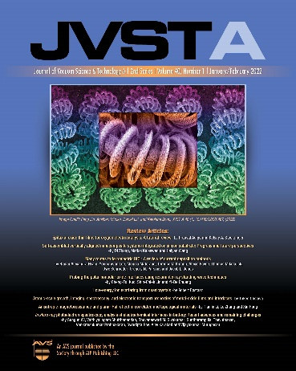
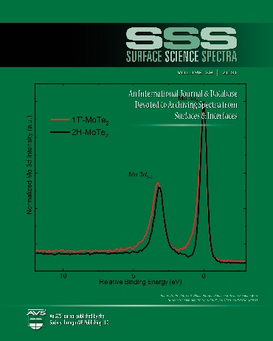
Interested in AVS Publications?
Journal of Vacuum Science & Technology A publishes original research, letters, and reviews on interfaces and surfaces of materials, thin films, and plasmas
Journal of Vacuum Science & Technology B publishes original research, letters, and reviews on microelectronics & nanotechnology
AVS Quantum Science
(co-published with AIPP)
covers topics such as condensed matter, atomic, molecular and optical physics, biology, chemistry, materials science, and computer science and engineering, all through the foundations of Quantum Science
Surface Science Spectra
publishes reference, comparison, and technical spectra of XPS, AES, SE, UV-vis, LEIS and SIMS data
Biointerphases emphasizes quantitative characterization of biomaterials and biological interfaces
Learn more at https://avs.org/publications-library/

Slide 20
Publications
LEARN MORE AT WWW.AVSPUBLICATIONS.ORG

Slide 21
AVS Events Calendar & Social Media
Follow Us on Social Media and Visit the AVS Events Calendar at:
www.avs.org/Meetings-Exhibits/Events-Calendar
Website: www.avs.org
Questions? Contact Angela Klink, angela@avs.org

Slide 22
AVS Online Training
AVS is now offering online training options from short courses to webinars to e-Talks.
Website: www.avs.org
Questions?
Contact Heather Korff, heather@avs.org

Slide 23
Call for AVS Major Awards Nominations
Major Awards: Due March 10, 2025
Outstanding Theoretical and/or Experimental Accomplishments:
Medard W. Welch Award
Outstanding Research or Technological Innovation:
John A. Thornton Memorial Award
Outstanding Theoretical or Experimental Work by an Early Career Scientist: Peter Mark Memorial Award
Sustained and Outstanding Technical Contributions:
Fellow of the Society
Outstanding Performance in Technical Support of
Research and Development
George T. Hanyo Award

Slide 24
Call for AVS Student Awards Nominations
Student Awards: Due April 14, 2025
Outstanding Research by a Graduate Student:
Dorothy M. and Earl S. Hoffman
Award and Scholarship
Nellie Yeoh Whetten Award
Russell and Sigurd Varian Award
Graduate Research Award
Students May Apply for a National Student Award and One Division/Group Award in Each Year

Slide 25
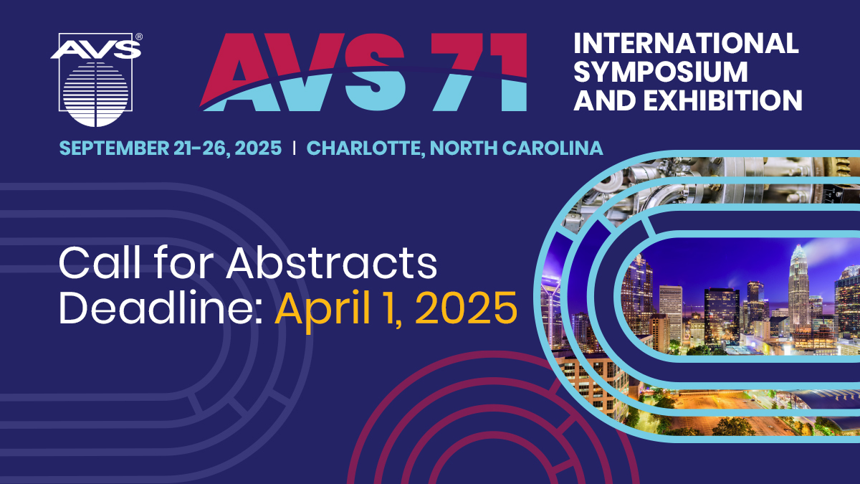
www.avs71.avs.org

Slide 26
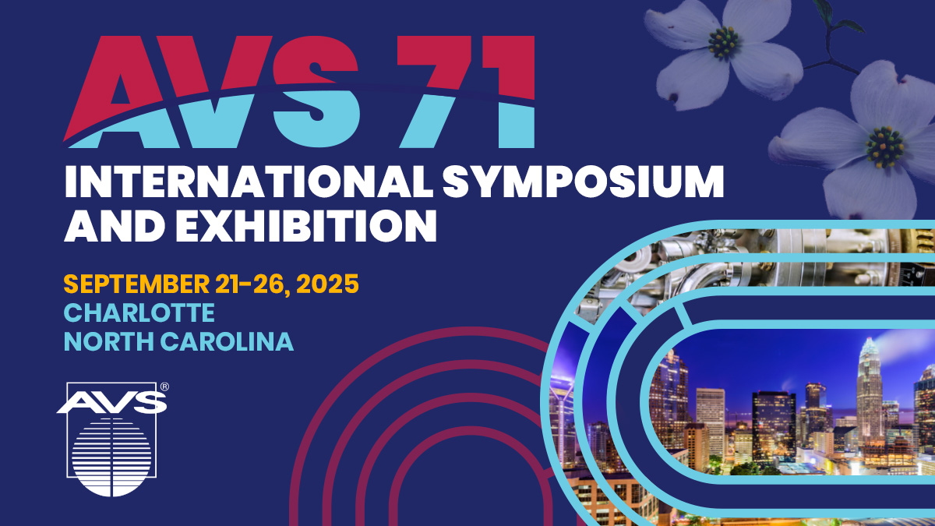
www.avs71.avs.org

Slide 27
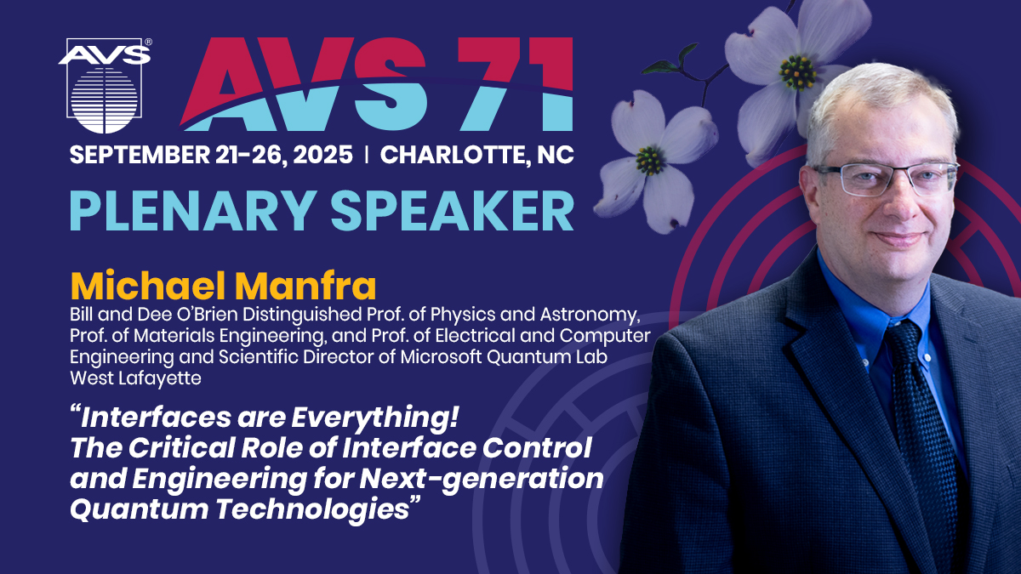
www.avs71.avs.org

