Slide 1
About AVS
Website: www.avs.org
AVS is an interdisciplinary, professional Society with 4,500 members worldwide, which supports networking among academic, industrial, government, and consulting professionals involved in a variety of disciplines - chemistry, physics, biology, mathematics, all engineering disciplines, business, sales, etc. through common interests related to the basic science, technology development, and commercialization of materials, interfaces, and processing. AVS is organized into ten technical divisions and two technical groups that encompass a range of established as well as emerging science and technology areas.
There are also regional chapters, international chapters and affiliates, and student chapters that promote communication and networking for professionals and students within a geographical region.

Slide 2
Why AVS
Website: www.avs.org
Highly multidisciplinary: 10 divisions, 2 technical groups, and a number of focus topics. All research areas are covered!
As you change jobs or roles, you do not have to change societies, you can just change affiliations within AVS.
AVS is a collaborative and inclusive society.
Colleagues will give you honest feedback on ideas or practices within the field.
AVS Member Benefits
AVS Symposium Benefits

Slide 3
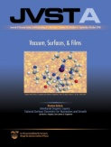
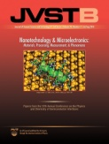
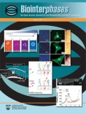
Be Part of the AVS Community
Join Us in Advancing the Science & Technology of Materials, Processing, & Interfaces
JVST A:
Surfaces, Interfaces, Materials
Thin Films, ALD, ALE
Plasma Science and Technology
JVST B:
Nanometer Structures
Microelectronics
Processing, Measurement, and Phenomena
Vacuum
Biointerphases:
Biomaterials & Biological Interfaces
Quantitative Soft Matter Interfaces
Chemistry Physics, Engineering, Theory, & Modeling
Surface Science Spectra (SSS):
Journal & Database for Individuals or Analytical Labs
6,600 Individual Spectra for More than 1,300 Specimens of Interest
Comparison Spectra from Well-Defined Materials
NEW! AVS Quantum Science:
Experimental and Theoretical Advances Across Physics, Chemistry, Biology, Materials Science, Optics, and Electronics
Networking
Career Services
Training & Professional Development
Technical Conferences, Meetings, & Exhibits
Professional & Student Awards
Leadership Opportunities
Technical Resources
Website: www.avs.org

Slide 4
AVS Membership Rates
This level is a full membership benefits package that requires payment of annual dues
$130
Platinum Full
$40
Platinum Student
Find More Membership Details at: www.avs.org/membership

Slide 5
Already an AVS Platinum Member?
Remember to Login to to Access Your Benefits
Expand Your Network
Form valuable contacts in academia, industry, and government
Collaborate with engineers, physicists, chemists, mathematicians, and biologists all working in materials, interfaces, and processing
Enhance Your Scientific & Professional Knowledge
FREE online access to JVST A, JVST B, Biointerphases, and SSS in the AVS Publications Library
International symposia and exhibitions and topical conferences
Local chapter activities and meetings
Professional development training and workshops
FREE online access to the AVS Technical Library featuring AVS Presentations on Demand, books, videos, etc.
Opportunity to Develop & Practice Your Leadership Skills
Lead or volunteer on a local, national, or international committee or division
Develop symposia programming
Participate in advocacy programs
Discounts on Subscriptions, Meeting Attendance, Hotels, Insurance, and More
Website: www.avs.org

Slide 6
AVS Publications
Publish Your Research Where it will be Read Worldwide by the Materials, Processing, & Interfaces Community
JVST A:
Surfaces, Interfaces, Materials
Thin Films, ALD, ALE
Plasma Science and Technology
JVST B:
Nanometer Structures
Microelectronics
Processing, Measurement, and Phenomena
Vacuum
Surface Science Spectra (SSS):
Journal & Database for Individuals or Analytical Labs
6,600 Individual Spectra for more than 1,300 Specimens of Interest
Comparison Spectra from Well-Defined Materials
Biointerphases:
Biomaterials & Biological Interfaces
Quantitative Soft Matter Interfaces
Chemistry Physics, Engineering, Theory, & Modeling
New! AVS Quantum Science
Experimental and Theoretical Advances Across Physics, Chemistry, Biology, Materials Science, Optics, and Electronics
AVS journals are peer-reviewed, easy to access, highly cited, & topically diverse …
For Submission Guidelines/Other Details:
www.avspublications.org

Slide 8
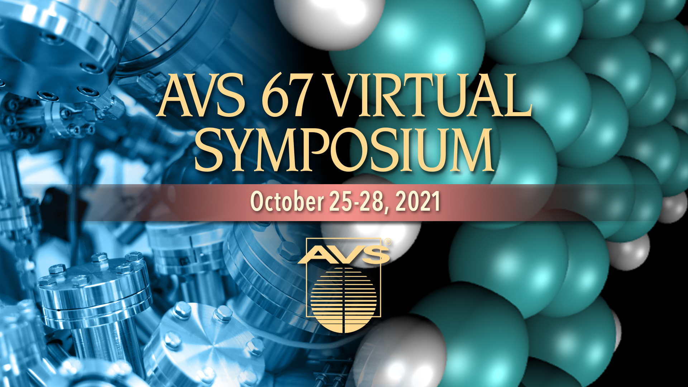

Slide 9
From the AVS Website www.avs.org
Follow Us on Social Media and Visit the AVS Events Calendar at:
www.avs.org/Meetings-Exhibits/Events-Calendar
Questions? Contact Angela Klink, angela@avs.org

Slide 10
AVS Online Training
AVS is now offering online training options from short courses to webinars to e-Talks.
From the AVS Website www.avs.org
Follow Us on Social Media and Visit the AVS Events Calendar at:
www.avs.org/Meetings-Exhibits/Events-Calendar
Questions? Contact Heather Korff, heather@avs.org

